Slide 1
Discourse
Alexander Spangher

Slide 2
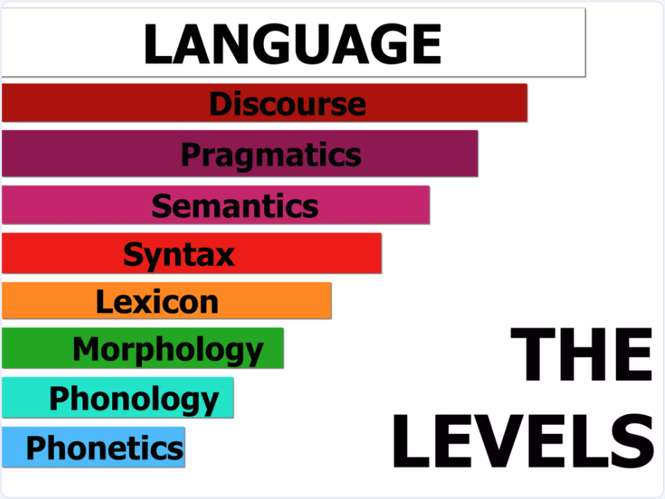

Slide 3
What is discourse?
Syntax:
The study of the structure and rules governing the arrangement of words and phrases in sentences.
Semantics:
The branch of linguistics that focuses on the meaning of words, phrases, sentences, and texts.
Pragmatics:
The study of how context influences the interpretation of meaning in communication.
Discourse:
Refers to the structure and use of language in communication beyond individual sentences. It involves analyzing how sentences connect to form cohesive and coherent texts or spoken interactions, considering context, purpose, and social dynamics.

Slide 4
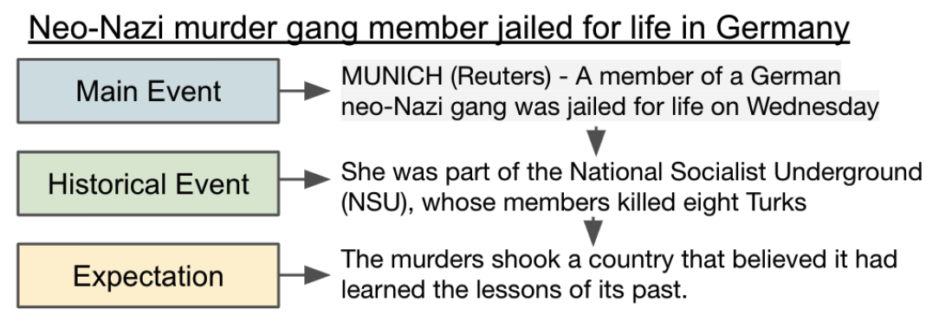
You have seen discourse already this semester!
Discourse:
Refers to the structure and use of language in communication beyond individual sentences. It involves analyzing how sentences connect to form cohesive and coherent texts or spoken interactions, considering context, purpose, and social dynamics.
News Discourse!

Slide 5
Classical Discourse

Slide 6
Penn Discourse Treebank
Simplest definition of discourse
connective
Text block 1
Text block 2
Draws from grammatical cohesion theory (Halliday and Hasan, 1976), coherence relations (Hobbs, 1979), connectives (Schiffrin, 1986)

Slide 7
Penn Discourse Treebank
Explicit Relations
connective
Text block 1
Text block 2
Causal: She left early because she was tired.
Contrast: He wanted to go out but it was raining men.
Temporal: We arrived late. So, we missed the show.
Expansion: He loves outdoors. For example, he goes hiking like a king.

Slide 8
Penn Discourse Treebank
Implicit Relations
connective
Text block 1
Text block 2
Causal: She left early. She was tired.
Comparison: She left home. He went out.
Temporal: We arrived late. They arrived later.
Expansion: He loves outdoors; the outdoors are where mushrooms grow.

Slide 9
From PDTB to Rhetorical Structure Theory
Causal (PDTB): She left early because she was tired.
Cause (RST):
Cause
She left early
(nucleus)
She was tired
(satellite)
The nucleus contains the primary information or central argument.
The satellite provides supplementary information, such as evidence, context, or explanation.

Slide 10
Rhetorical Structure Theory
Provides a way of analysing longer chains of thought:
"John missed the meeting. He was stuck in traffic. He should have left earlier."
John missed meeting
(nucleus)
Cause
Counterfactual
He should have left earlier.
(satellite)
He was stuck in traffic
(satellite)

Slide 11
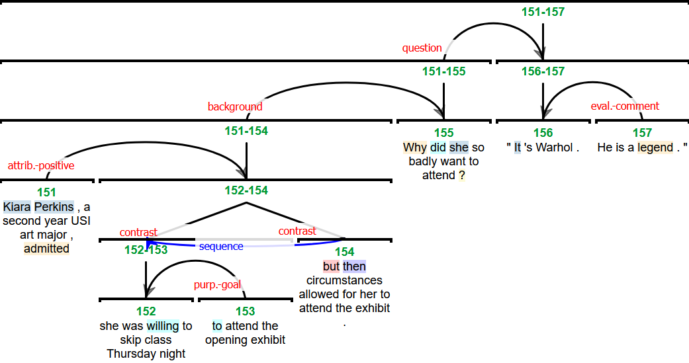
Rhetorical Structure Theory

Slide 12
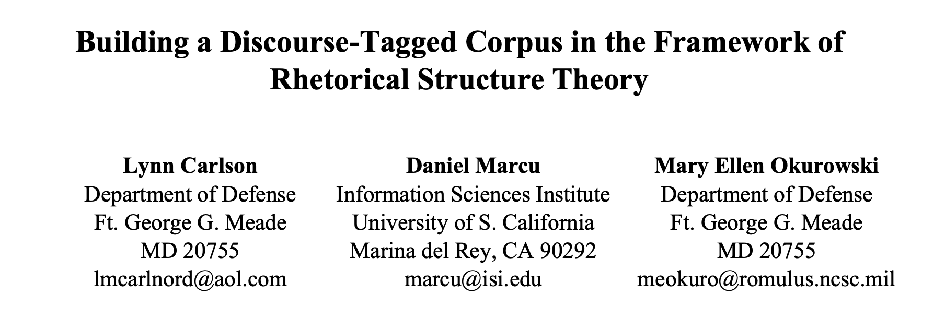
Rhetorical Structure Theory

Slide 13
Modern Discourse Theory

Slide 14
Discourse as structural markers
Discourse:
Refers to the structure and use of language in communication beyond individual sentences. It involves analyzing how sentences connect to form cohesive and coherent texts or spoken interactions, considering context, purpose, and social dynamics.
News Discourse (Van Dijk, 1989)

Slide 15
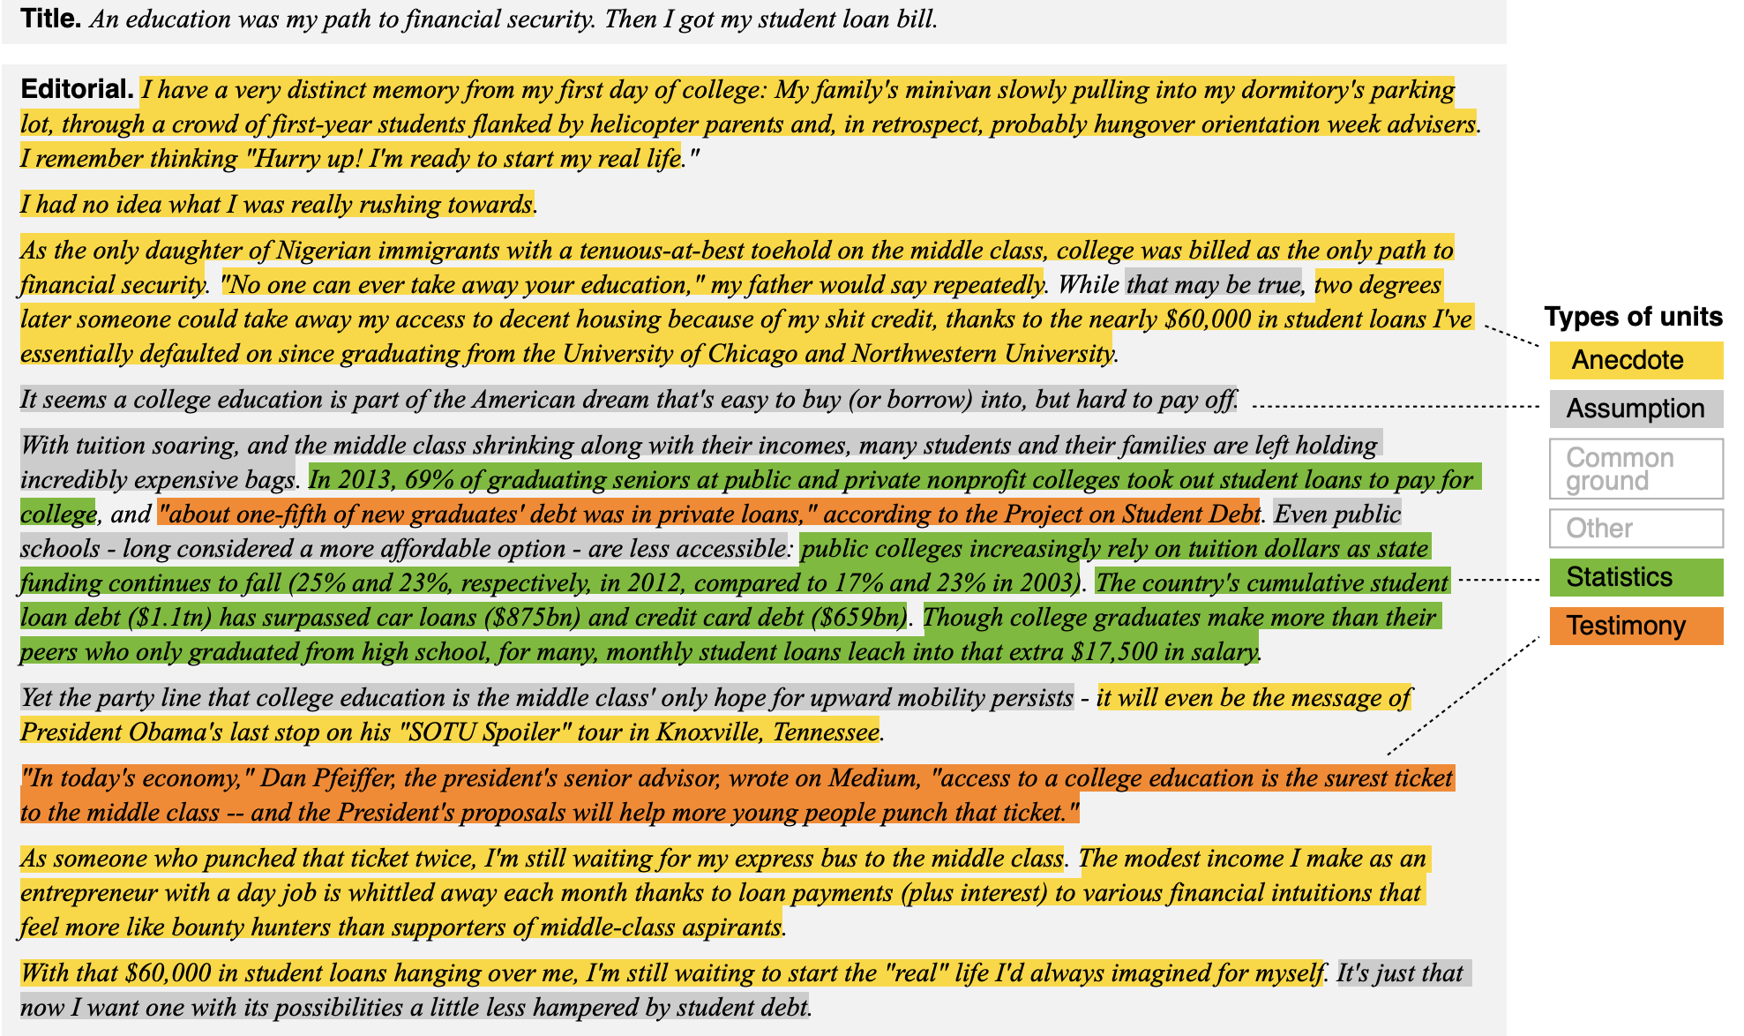
Argumentation Discourse (Khatib, 2016)

Slide 16
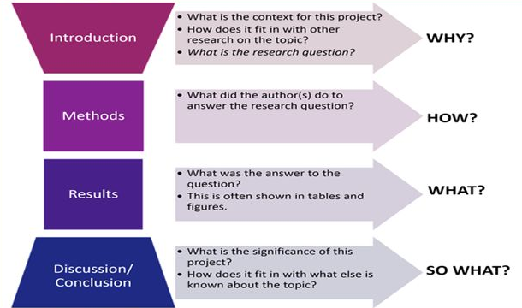
Science Discourse

Slide 17
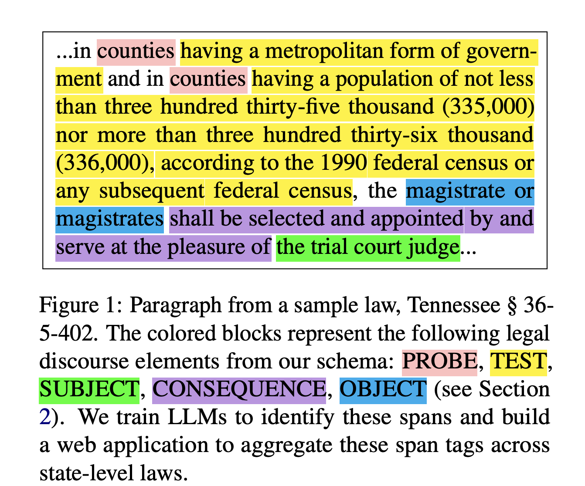
Legal Discourse
Spangher, A., Wu, T.-L., Xue, Z., Hansen, M., & May, J. (2024). LegalDiscourse: Interpreting when laws apply and who they affect.
NAACL 2024

Slide 18
What can discourse tell us?

Slide 19
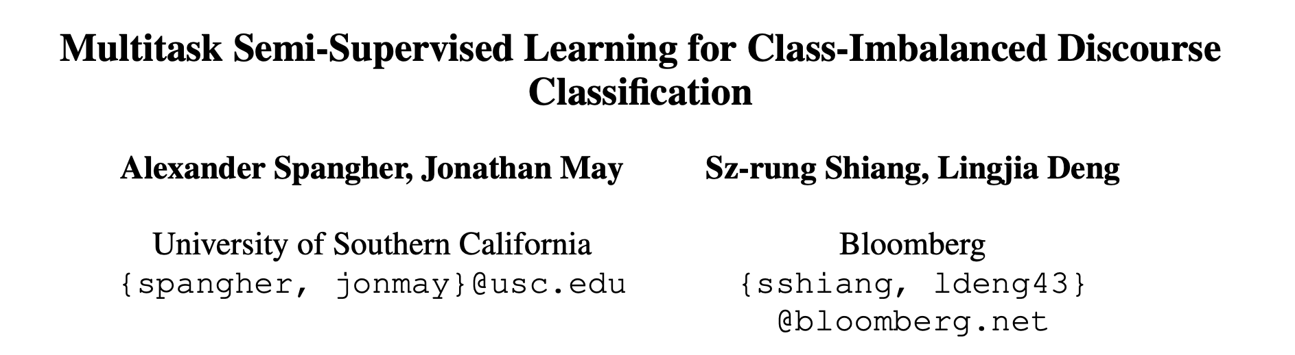
What can discourse tell us?
Insight #1: Different discourse-types complement each other.

Slide 20
Task: Classify News Discourse
Type
Label
Many different discourse datasets are annotated on news!
Yarlott, 2018: Van Dijk Schema
Choubey, 2020: Van Dijk Schema + Anecdote
Spangher, 2021: Van Dijk Schema + Explanation
Al Khatib, 2016: Argumentation Schema
Prasad, 2008: Penn Discourse Treebank (PDTB)
Carlson, 2003: Rhetorical Structure Theory Treebank (RST)
Main Event
Main Content
Consequence
Previous Event
Contextualizing
Content
Current Context
Historical Event
Additional
Supporting
Content
Anecdotal Event
Evaluation
Expectation

Slide 21
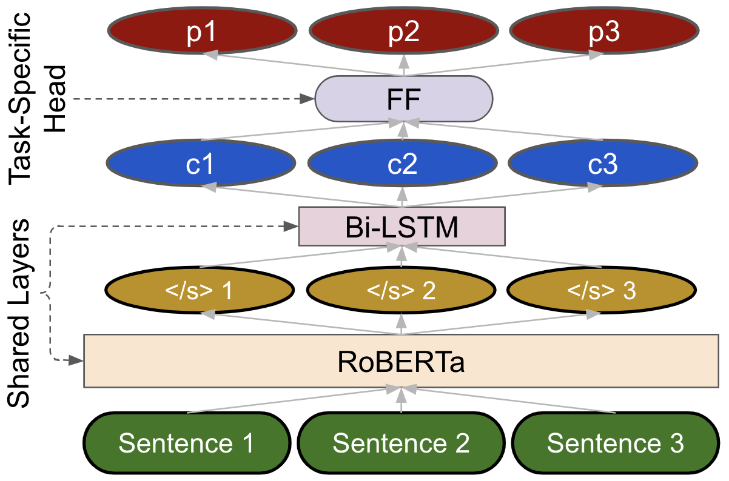
Multitask Architecture

Slide 22
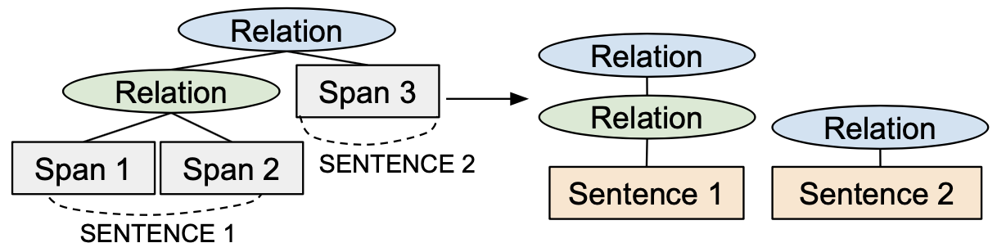
Additional Details on Data Processing
PDTB and RST are relational datasets. We need to process them to model them as multilabel datasets.
Additionally, we filter tags in PDTB to only include tags on temporal relations.
We experiment with Event Nuggets Dataset from Knowledge Base Population (KBP) 2014/2015. [6]

Slide 23
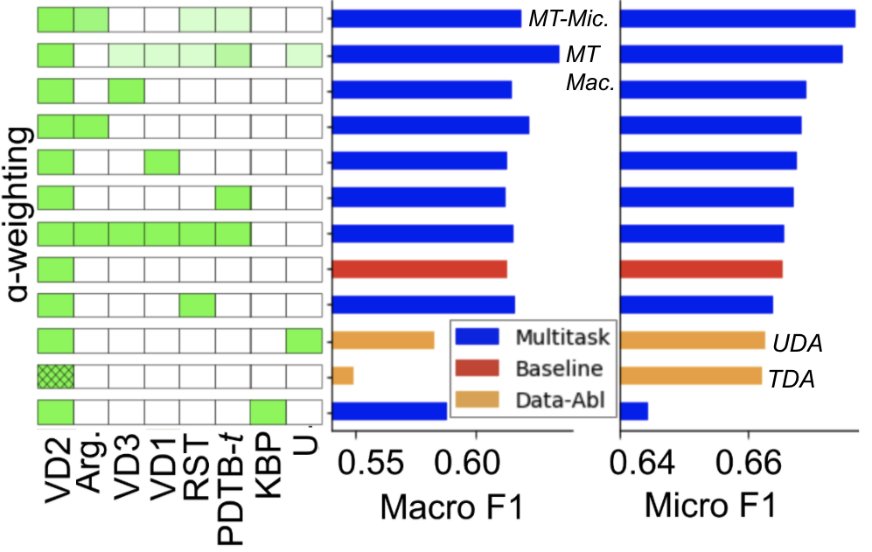
Multitask Outperforms Baseline and Data Ablations
Notes:
Say that semi-supervised learning is still a field we’d like to explore more
Look at the dataset sizes for semi-supervised task
Hyperparameter tuning -- performance improvements after the
We will still explore semi-sup as the TODO work
This is confusing -- what is data augmentation, how do you get this, what is the semi-supervised setting?
Needs some introduction here -- include another slide about what we’re about to see before this slide.
Be aware of the label-set size for each multitask

Slide 24
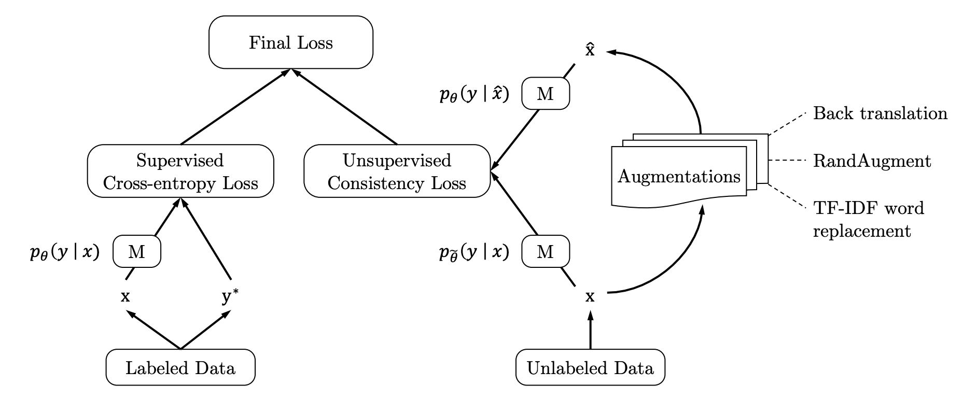
Two Data Ablations:
Training Data Augmentation (TDA) [6]
  For each labeled pair (X, Y) in training set:
    Generate k augmentations (X’, Y)
    Add these to the dataset
  Augmentation method: Back-translation (ex. English -> German -> English)
Unsupervised Data Augmentation (UDA) [7]

Slide 25
Multitask Outperforms Baseline and Data Ablations
Notes:
Say that semi-supervised learning is still a field we’d like to explore more
Look at the dataset sizes for semi-supervised task
Hyperparameter tuning -- performance improvements after the
We will still explore semi-sup as the TODO work
This is confusing -- what is data augmentation, how do you get this, what is the semi-supervised setting?
Needs some introduction here -- include another slide about what we’re about to see before this slide.
Be aware of the label-set size for each multitask

Slide 26
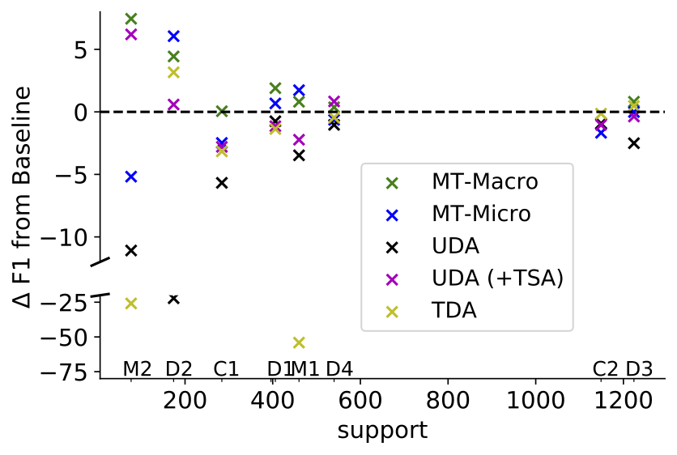
Multitask Learning Boosts Performance of Low-Support Classes

Slide 27
What can discourse tell us?
Insight #1: Different discourse-types complement each other.

Slide 28

What can discourse tell us?
Insight #2: Discourse Helps Us Structure Text

Slide 29
{ “company”: “Apple Inc.”,
“datetime”: “01/01/2020”,
“eps”: “$5” … }
Step 1:
Given data,
propose article
structure
HEADLINE
Graf 1: Main Event
Graf 2: Context
Step 2:
Generate background
paragraphs
Step 3:
Model for recommending
sources
Graf 3: Expectation, Quote
Graf 4: History

Slide 30
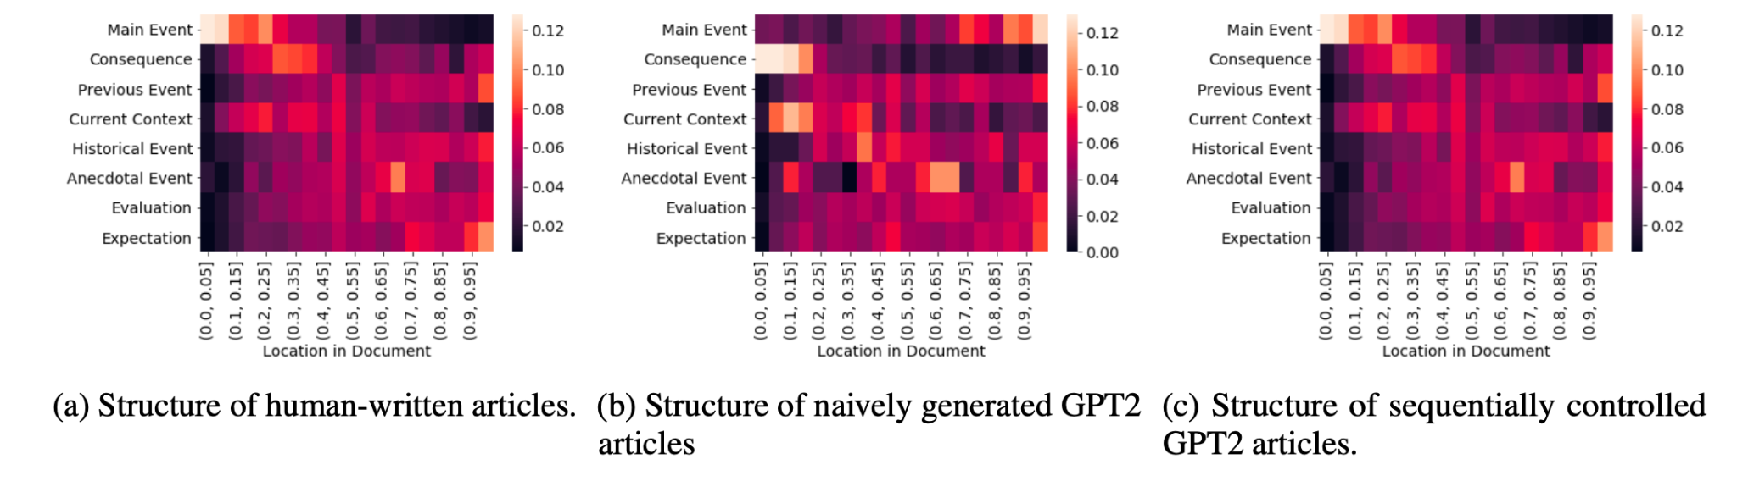
Right now, there’s no good way to control the structure of text generated by language models:

Slide 31
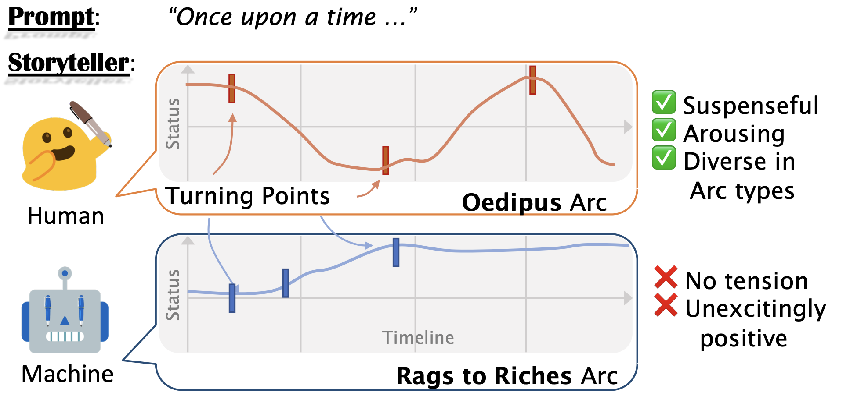

We still see this with more recent models
Tian, Y., Huang, T., Liu, M., Jiang, D., Spangher, A., Chen, M., May, J., & Peng, N. 2024. Are large language models capable of generating human-level narratives? EMNLP 2024

Slide 32
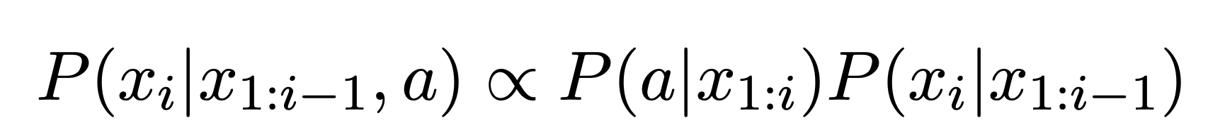
Controlled Text Generation
X_{i} is the current word you want to generate
X_{1… i-1} are the previous words you’ve generated
a is the control code

Slide 33
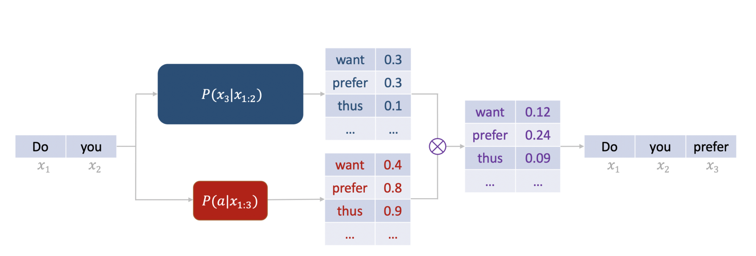
Controlled Text Generation

Slide 34
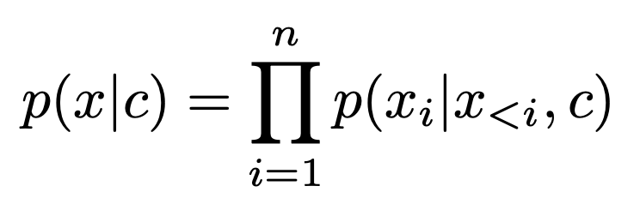
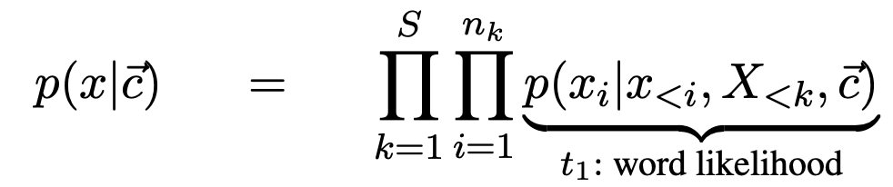
Sequentially Controlled Sequence Generation
Can we control the structure of text using a sequence of tags?
Instead of:
We have:
Where:
\vec{c} is a sequence of local control tags
S is the number of sentences (equal to the number of control codes)
X_{<k} are the previous sentences generated
x_{<i} are the previous words in the current sentence
x_{i} is the current word in the sentence

Slide 35
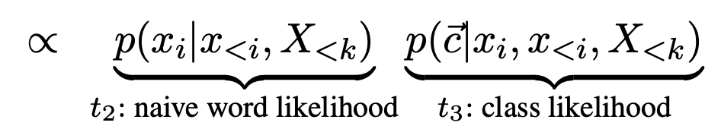
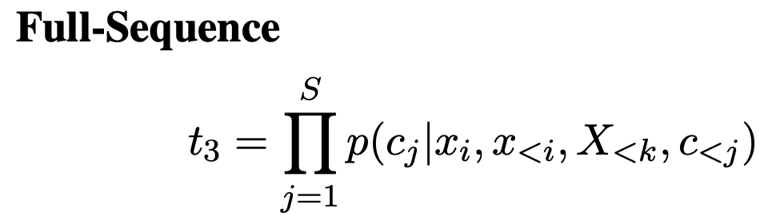
Factorization:
Naive language model (GPT2)
(except it needs to be able to generate enough words for a full news article ~2048 word pieces)
Discriminator…
How do we train a discriminator to predict a vector???

Slide 36
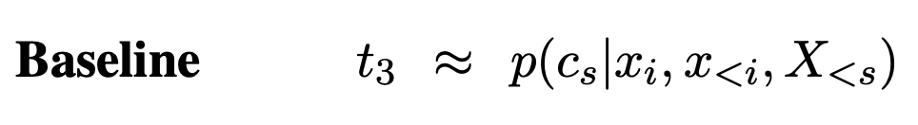
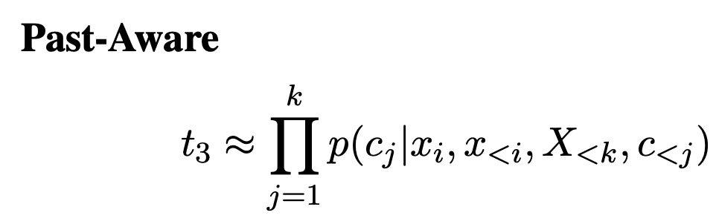

Slide 37
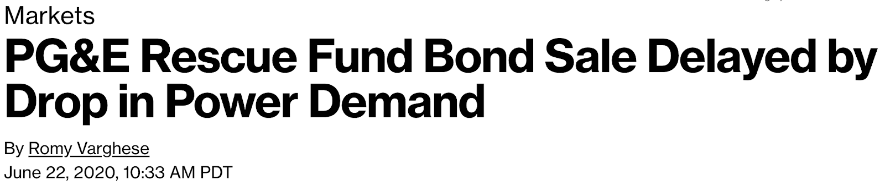
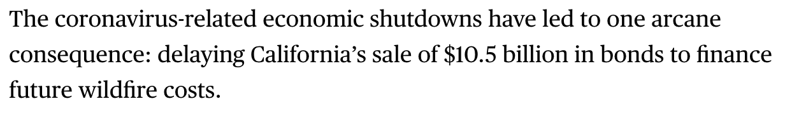
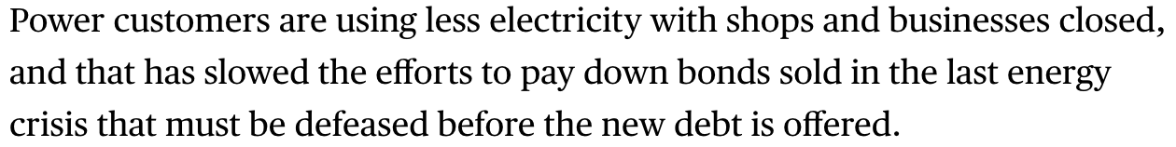
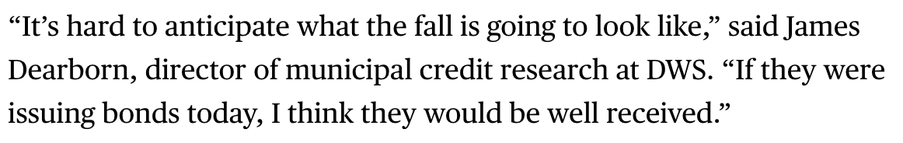
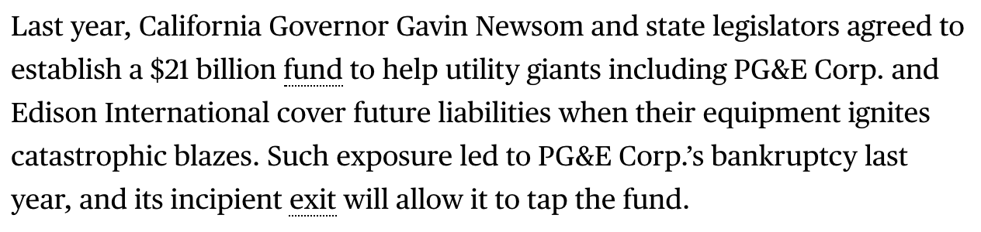
Dataset
Van Dijk News Discourse
Choubey, Prafulla K., et al. "Discourse as a function of event: Profiling discourse structure in news articles around the main event." ACL. 2020.
https://aclanthology.org/2020.acl-main.478/
Main
Event
Spangher, A., May, J., Shiang, S. R., & Deng, L.
Multitask learning for class-imbalanced discourse
classification. https://arxiv.org/abs/2101.00389
Context
NewsDiscourse: 800 articles
9 discourse labels:
Main Event
Background
Context
Evaluation
Sentence-level annotation
Verbal
Reaction
History

Slide 38
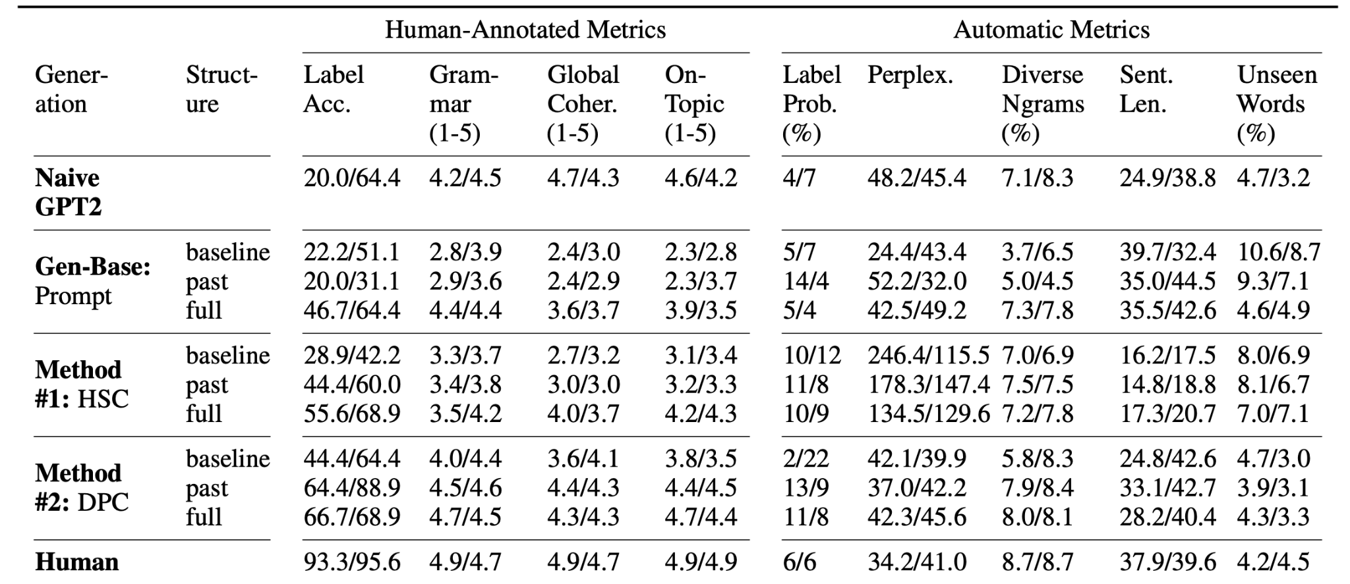
Results

Slide 39
Ongoing Work
Facebook Post
Tweet
Jialiang, Tenghao, Alex, Muhao
Using genetic algorithms and GPT4 to generate summaries with specific kinds of structure
News article
LinkedIn

Slide 40
What can discourse tell us?
Insight #2: Discourse Helps Us Structure Text

Slide 41
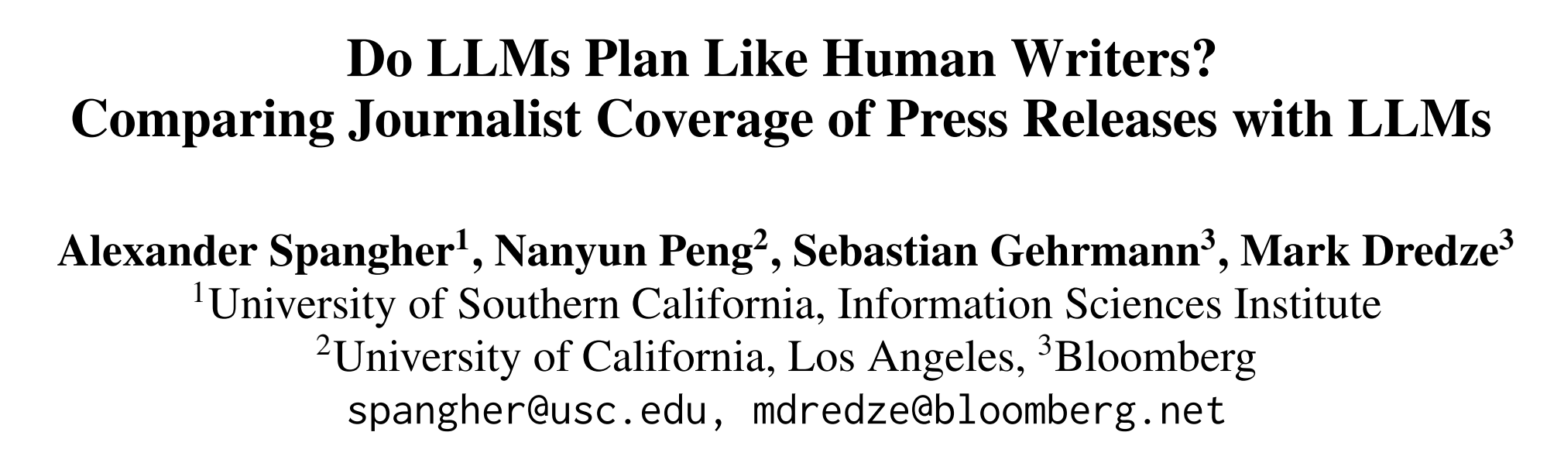
What can discourse tell us?
Insight #3: Discourse Can Help Us Plan

Slide 42
News Coverage
Finding background
Calling a source
Calling another source
a₁
a₂
a₃
a₄
actions:
…
d₁
d₂
discourse:
…
words:
…
w₁
w₂
w₃
w₄

Slide 43
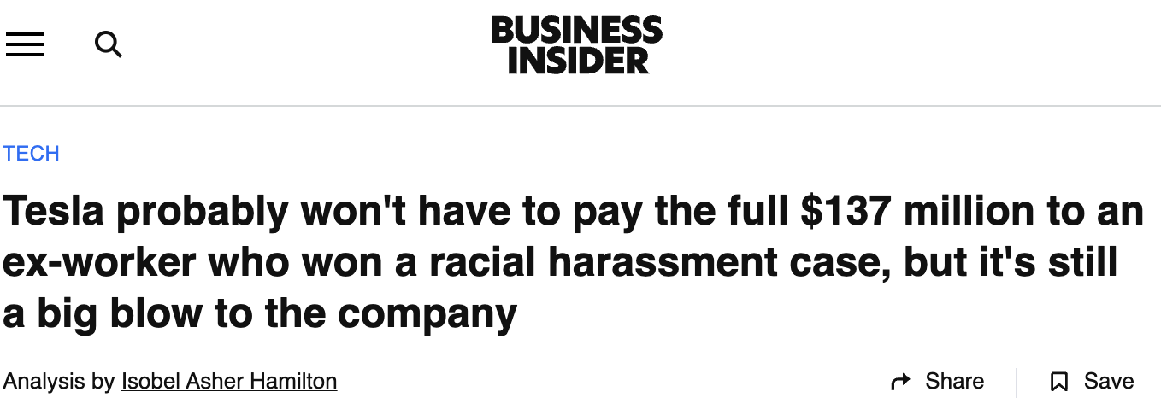
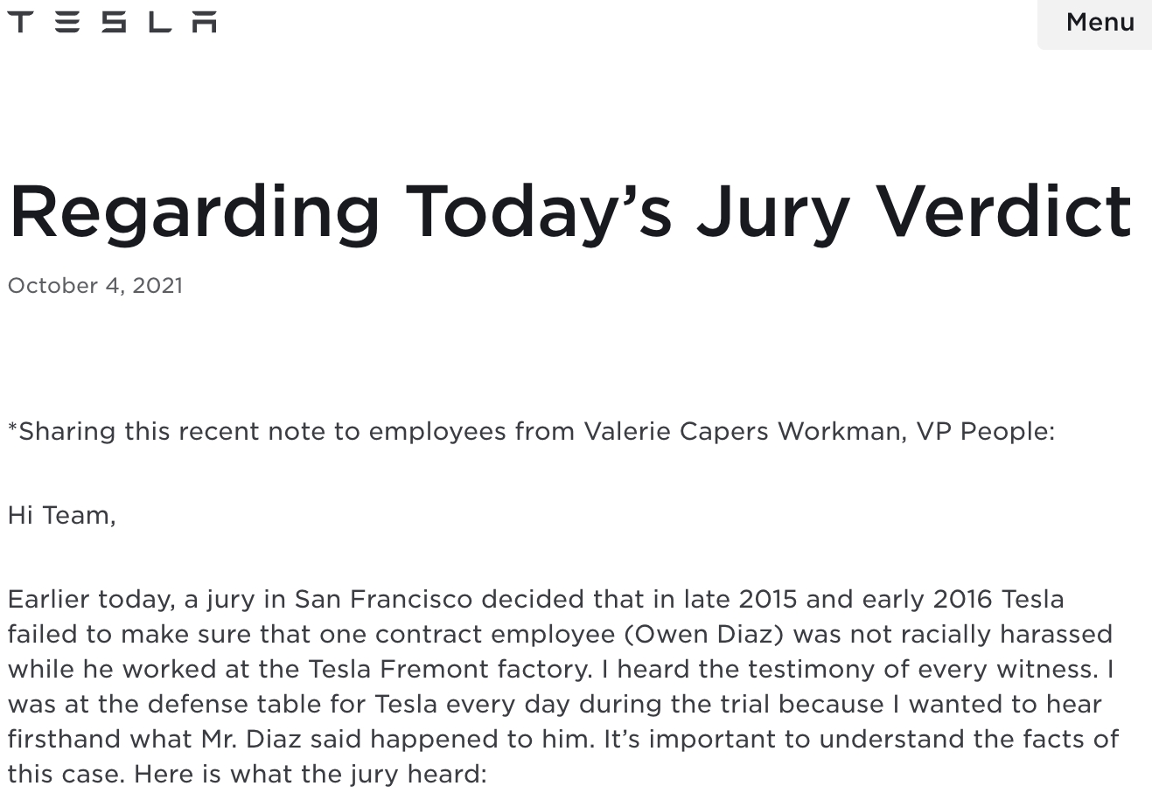
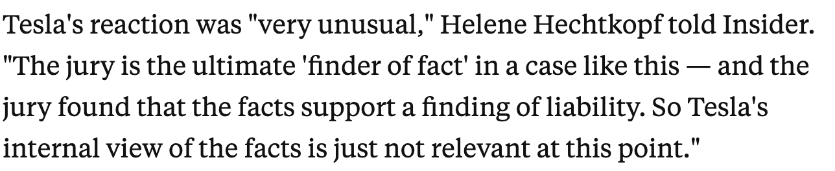
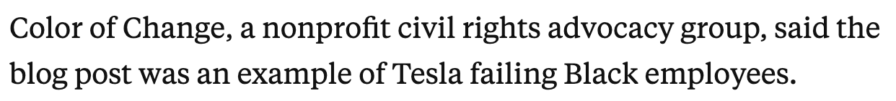
News Coverage of Press Releases
Angle: de-spin
Source: contextualization
spin
Source: broadening

Slide 44
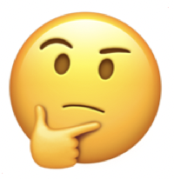

Goal
LLMs are being used increasingly as aids in human workflows.
We need to understand how their decisions differ from those humans would have made.
How well do LLM planning suggestions align with the decisions humans make?
How creative are LLM planning decisions?
Is this part of a larger, negative pattern?
Let’s describe the event in detail…
Angle
Source #1
Employment
lawyer
Spokesperson
Source #2
Advocacy
group
Business professor
Source #3
Insider
Legal professor

Slide 45
Inferring Human Plans
Human plan:
LLM
Is this part of a larger, negative pattern?
Here is a press release: {{Press_Release}}
Here is a news article: {{News_Article }}
Angle
Press
Release
(Angle) What specific focus does the journalist take? How does they challenge "spin", or positive portrayals?
(Sources) Which kinds of sources does the human use in their reporting?
Source #1
Employment
lawyer
News
article
Source #2
Advocacy
group
Source #3
Insider

Slide 46
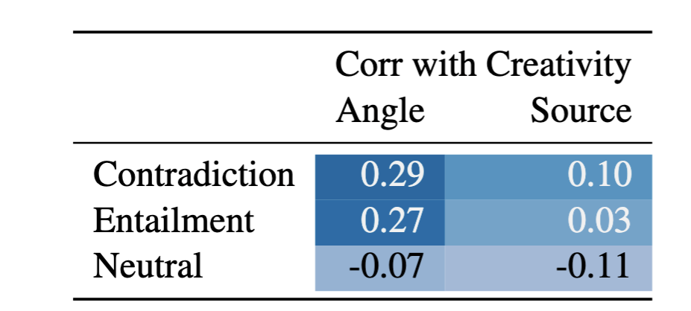
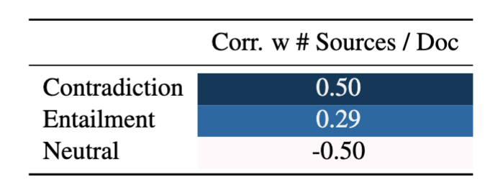
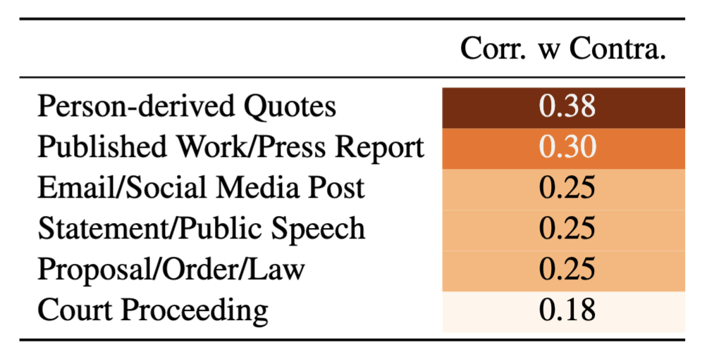
Insights
Insight #1: Effective coverage has significantly more creative angles, slightly more creative sources.
Insight #2: Effective Coverage uses more sources
Insight #3: Effective coverage uses more labor intensive sources.

Slide 47
Main Experiment: Comparing LLM Planning to Human
Press release
Press release
News article
LLM
LLM
(Angle) What are potential directions to investigate? How would a news article de-spin this?
(Sources) What are some kinds of sources I should use to pursue these angles?
(Angle) What specific focus does the journalist take? How does they challenge "spin", or positive portrayals?
(Sources) Which kinds of sources does the human use in their reporting?
Let’s describe the event in detail…
Is this part of a larger, negative pattern?
Angle
❌
❌
Source #1
Spokesperson
✅
❌
Employment lawyer
Source #2
Business professor
❌
Advocacy group
❌
Source #3
Legal professor
Insider
❌

Slide 48
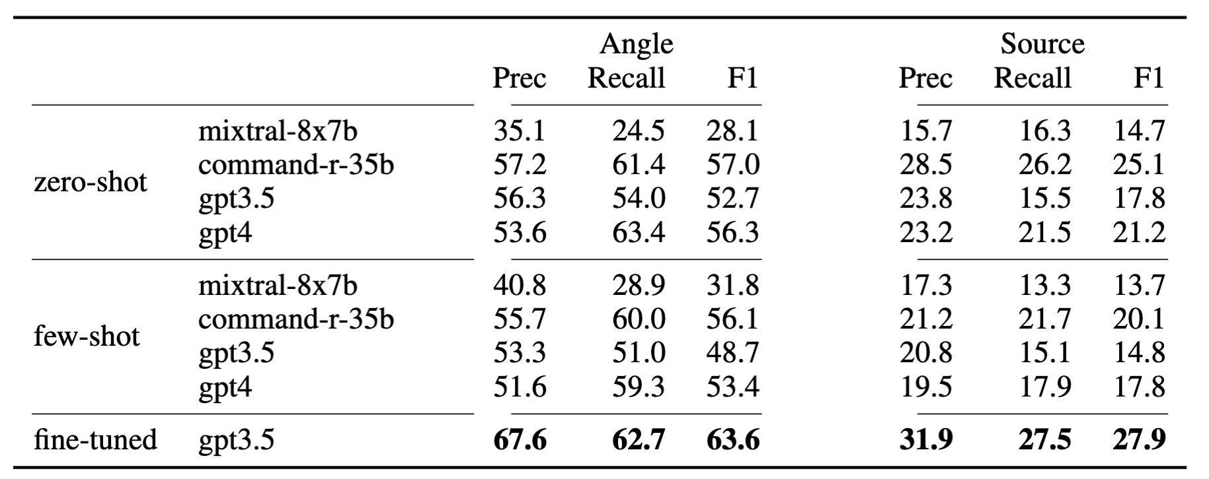
Result #1: LLMs do well at suggesting angles that humans use, but are less likely to suggest the right kinds of sources

Slide 49
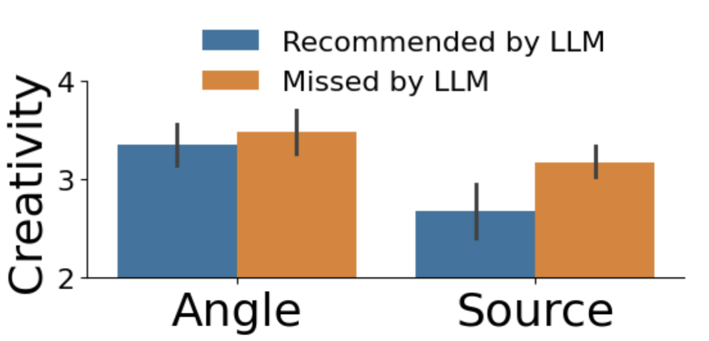
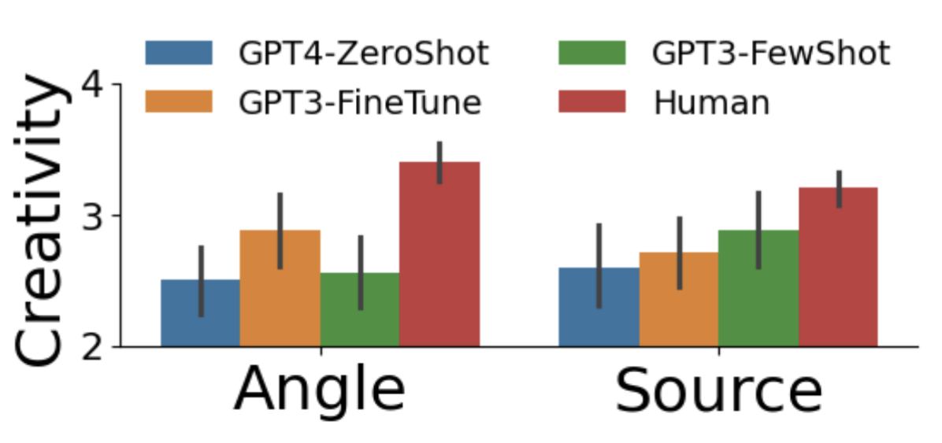
Result #2: LLMs are significantly less creative than humans

Slide 50
What can discourse tell us?
Insight #3: Discourse Can Help Us Plan

Slide 51
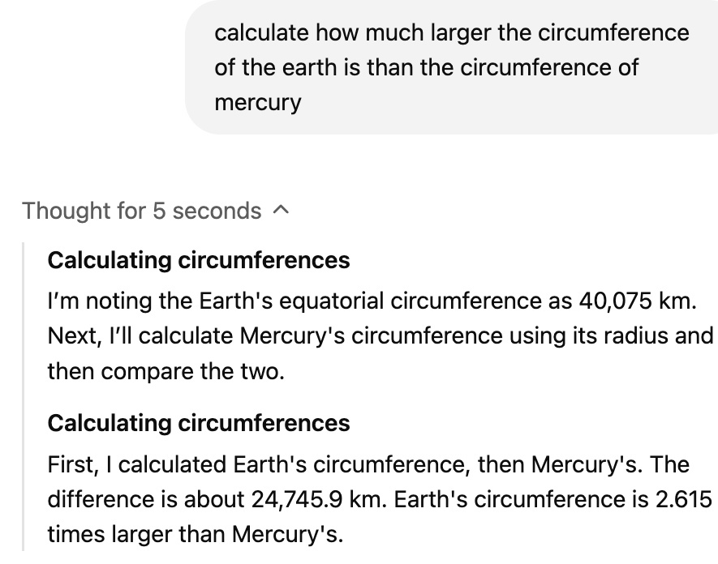
Takeaways
We are seeing over, and over, and over again that naive language modeling doesn’t capture:
Human-like discourse structure
  Although this is very learnable with some supervision!
Human-like plans (or action-sequences) are not like LLM plans.
  Is this learnable?

Slide 52
Post-Modern Discourse:
Learning our own discourse schemas

Slide 53
TopicGPT

Slide 54
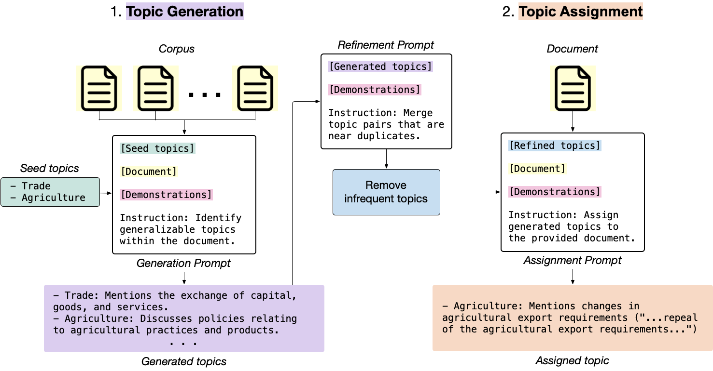
TopicGPT

Slide 55
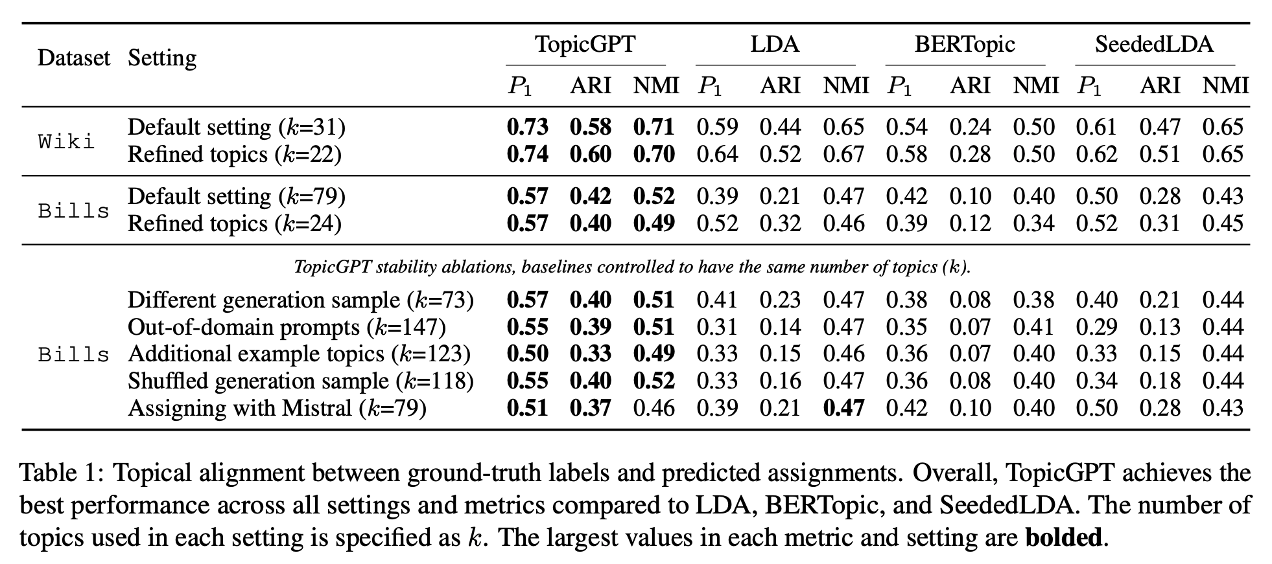
TopicGPT

Slide 56
Observation: the initial prompt can change
>>> What narrative role does this source play?
{source}
'"Authority": This source is used to provide information about the Framingham Heart Study and its findings.'
"Illustrator": This source is used to provide information about the artwork
"Expert": This source is used to provide information about the development…

Slide 57
Observation: removing seeds increases the creativity
Existing lists/seeds can constrain the creativity of LLM.
We found that the LLM does better without any existing seeds.

Slide 58
Observation: Improvement needed on refinement step
Original Approach: Uses SBERT to embed each topic. Calculates cosine similarity and clusters topics based on >.5 (Note: BERTopic does this too.)
This often fails with more complicated discourse tags!
Error Example:
"Insight": This source provides insight into Huawei's strategy for licensing its 5G technology to US companies.
"More Context": This source provides more context for events happening at the time so we can better understand the impacts.
"Example": This source is used as an example to illustrate the mobile payment solution.”

Slide 59
Observation: Improvement needed on refinement step
Our approach:
Use LLM to label 400,000 pairs of labels as “same” and “not same”
Train SBERT bi-encoder using this supervised data.
Naive SBERT:
F1 = .35
Trained SBERT:
F1 = .65
Avg. cosine distance
no 0.280045
yes 0.365856
Avg. cosine distance
No 0.348549
Yes 0.517865

Slide 60
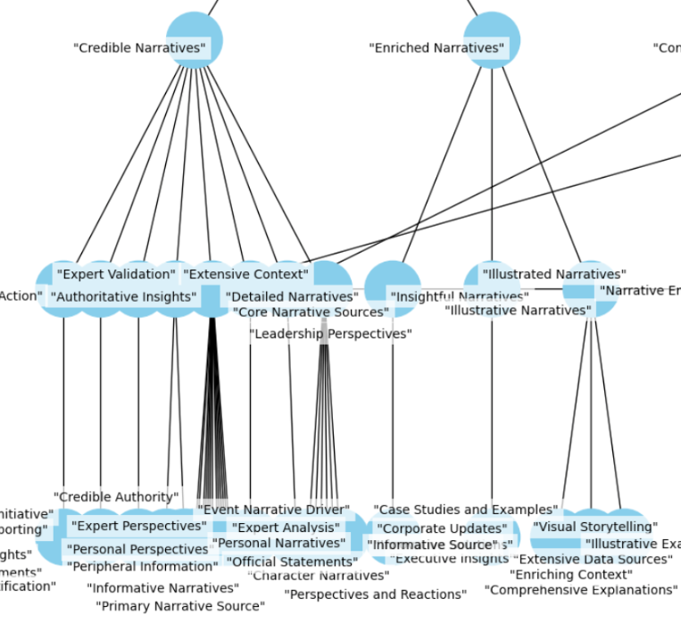
Observation: We can hierarchically cluster
Approach: like BERTopic, we can use hierarchical clustering methods to cluster groups.
Then, we can use GPT to generate cluster labels for each group

Slide 61
Observation: We can hierarchically cluster
'"Disclaimer": This source is used to provide legal disclaimers…
>
'"Legal and Disclosure": This collection of sources is used to provide legal disclaimers, copyright information, data protection notices
>
'"Transparency and Compliance": This collection of sources is used to provide critical legal disclaimers, copyright information, data protection notices, transparency statements, funding details, affiliations, conflicts of interest, and practices and policies
>
'"Source Credibility": This label provides comprehensive information regarding the financial, professional, and biographical context, including affiliations, legal compliance, conflicts of interest
>
'"Enhanced Narrative Integrity": These sources collectively provide extensive background information, credible insights, data, context, and authoritative perspectives, ensuring the accuracy, reliability, and engagement of various articles and topics.',

Slide 62
Thanks!
Questions?
spangher@usc.edu

