Slide 1
Machine Translation:
History, Evaluation
CSCI 662
Jonathan May
many slides from Philipp Koehn

Slide 2
Today
Introduction to MT
Evaluation of MT
Intuition behind learning word translations

Slide 3
Translation is a Very Old Problem
The Tower of Babel (Peter Bruegel the Elder, 1563)

Slide 4
Translation is a Very Old Problem
Rosetta Stone
Hieroglyphics, Demotic, Ancient Greek
Translated 1803-1822
Advantage: we already knew some Ancient Greek!

Slide 6
Early Efforts and Disappointment
Excited research in 1950s and 60s
  1954 Georgetown experiment: Machine could translate 250 words and 6 grammar rules
  these machines were less powerful than high school calculators
  note: “AI” term coined 1956
1966 ALPAC report:
  only $20m spent on translation in the US/year
  not that much Russian we want to translate
  Money is better spent teaching humans Russian!

Slide 7
Rule-Based Systems
General approach:
  build dictionaries
  write transformation rules
  refine, refine, refine
Météo system for weather forecasts (1976)
  Canadian French-English
  Success story! Limited domain
Systran (1968)
  Offshoot of Georgetown experiment
  Still around! Rule-based until 2010. Now based in France.
Logos, Metal (1980s)

Slide 8

2010
2020

Slide 9
2020

Slide 10
For High Resource Languages, Pretty Good!
How Good is Machine Translation?

Slide 13
Machine Translation: Samoan
O lenei tulafono taufa’aofi mai le faigamalo a Lolo ma Lemanu, na taunu’u i luma o le Fono Faitulafono i le vaiaso mulimuli o galuega a maota e lua, ma faia ai loa le fa’aiuga ina ia taofia le iloiloina o nei tulafono seia toe a’e mai galuegaa le Fono i le tauaofiaga lona 3, lea e fa’amoemoe e usuia i le aso Gafua lona 2 o le masina o Iaunari 2018.
=Monday
This lawyer from the government of Lolo and Leman came before the Legislative Assembly in the last week of the two cabinets, making the decision to stop the review of these law until the Council's return to the third session, which is expected to be held on the 2nd of the month of June 2018.
June = Malelaga

Slide 14
Samoan 2021 – Low Resource Languages are improving!
O lenei tulafono taufa’aofi mai le faigamalo a Lolo ma Lemanu, na taunu’u i luma o le Fono Faitulafono i le vaiaso mulimuli o galuega a maota e lua, ma faia ai loa le fa’aiuga ina ia taofia le iloiloina o nei tulafono seia toe a’e mai galuegaa le Fono i le tauaofiaga lona 3, lea e fa’amoemoe e usuia i le aso Gafua lona 2 o le masina o Iaunari 2018.
This lawyer from the government of Lolo and Leman came before the Legislative Assembly in the last week of the two cabinets, making the decision to stop the review of these law until the Council's return to the third session, which is expected to be held on the 2nd of the month of June 2018.
The bill from the Lolo and Lemanu governments came before the Legislative Assembly in the last week of business by both houses, and it was decided to suspend its consideration. law until the Council resumes business in its 3rd session, which is expected to be held on the 2nd Monday of January 2018.
2018
2021
This draft law from the government of Lolo and Lemanu, arrived before the Legislature in the last week of the work of the two houses, and the decision was made to stop considering these laws until the Assembly resumes its work in the 3rd session, which is expected to be held on the 2nd Monday of January 2018.
2024
Notes:
This draft law from the government of Lolo and Lemanu, arrived before the Legislature in the last week of the work of the two houses, and the decision was made to stop considering these law until the Assembly resumes its work in the 3rd session, which is expected to be held on the 2nd Monday of January 2018.

Slide 15
Very Low Resource: Still Terrible (Oromo)
Hanbaan dhukaatuu ykn boombii qaama xayyaaricha caccabee fi meeshaa imaltootaa irratti argameera .
MT (2017):
Hanbaan dhukaatuu or the bomb was found on the imaltootaa body xayyaaricha caccabee and equipment.
The remnants of explosives or bombs were found on the fragments of the airplane and the belongings of the travellers.
Truth:
Google 2021
(“somali”):
The bomber struck shortly after noon in front of a crowd of protesters.
Google 2022(24)
(“oromo”):
Remains of gunfire or bombs were found on the wreckage and passenger luggage

Slide 16
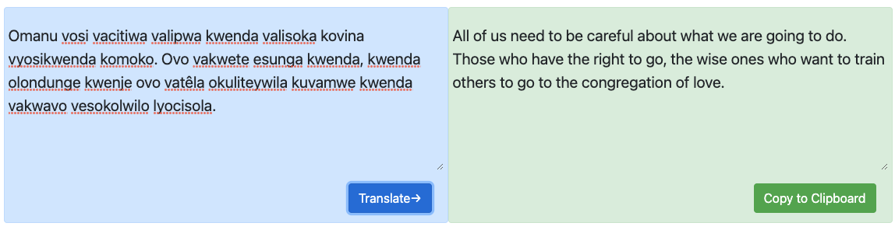
So Is Machine Translation Solved?
(and the quality seems pretty good!)
Google Language Support Increase: 64 (117) -> 103 (~ 2020) -> 133 (2023) -> 243 (2024)
ISI: 600-to-English MT (2021)
Umbundu (Bantu language spoken by 5-10m)
(Truth)
All human beings are born free and equal in dignity and rights. They are endowed with reason and conscience and should act towards one another in a spirit of brotherhood.
Google (2022)
Omanu vosi were forced to be paid to go to football games where things didn't go well. Ovo vakwete esunga go, go olondunge kwende ovo vatêla okuliteywila kuvamwe go vakwavo vesokolwilo lyocisola
Google (2024) “ndau”
All Omanu were paid to go and look for what was going on there. They were determined to walk, to walk in the light, and to share it with their brothers who were walking in the light.
Facebook: NLLB – 200 language translation project
(Research-grade so far...)
Notes:
41x4 + 40 + 39

Slide 17
Two Kinds of Error
Fluency: Is it good English (or other target language)?
  Grammatical Correctness
  Idiomatic Word choice
Adequacy: Did the meaning of the input get properly conveyed?
  Info lost
  Extra info added
Worst of Both Worlds:
  word salad
  untranslated words

Slide 18
Is It Good Enough?
Depends on what you want to do with it...
Assimilation: reader initiates translation, wants to know content
  user is tolerant of inferior quality; gist is fine
  focus of majority of research
Communication: participants don't speak same language, rely on translation
  users can ask questions when something is unclear
  chat room translations, hand-held devices, combined with speech recognition
Dissemination: publisher wants to make content available in other languages
  high demand for quality
  mt not sufficient; done almost exclusively by human translators
  but mt is used as first pass to speed things up

Slide 19


What are you doing?
Bank
By burying your cash down by the river?
zinsen
Ufer
interesse
I’m trying to become super popular!
Dad said if I put my money in a bank it would raise interest

Slide 20
(at least that’s what they claim)

Slide 22
cousin
cousine
Google 2023
He is my favorite cousin → Er ist mein Lieblingscousin
She is my favorite cousin → Sie ist meine Lieblingscousine
Wenn ich meinen Onkel und seine Töchter besuche, kann ich mich nicht entscheiden, wer mein Lieblingscousin ist.
X

Slide 23
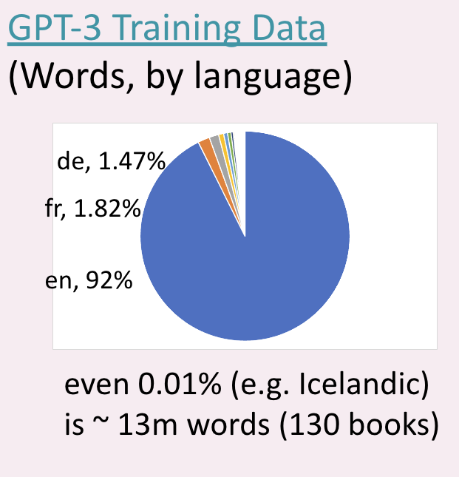
practicalities (all multiling)
almost every language has much less data available at all
we have a lot of assumptions baked in due to starting with english but many langs have:
  morphology
  fewer/no spelling conventions
  free word order
  writing system variants
    logographic
    abjad
    abugida
    multiple!

Slide 24
from graham neubig

Slide 25
How Do We Quantitatively Know If We're Doing a Good Job?

Slide 26
-- cross-lingual information retrieval results

Slide 32
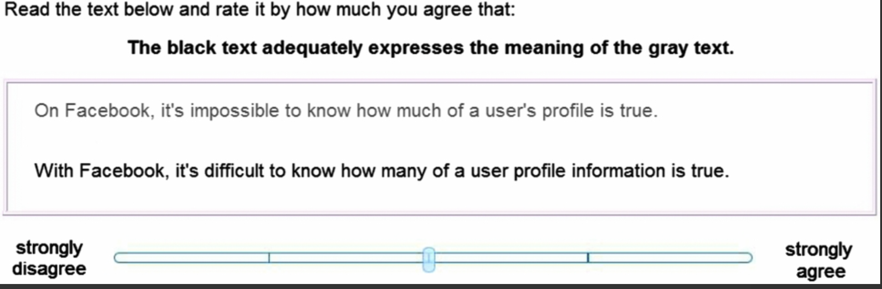
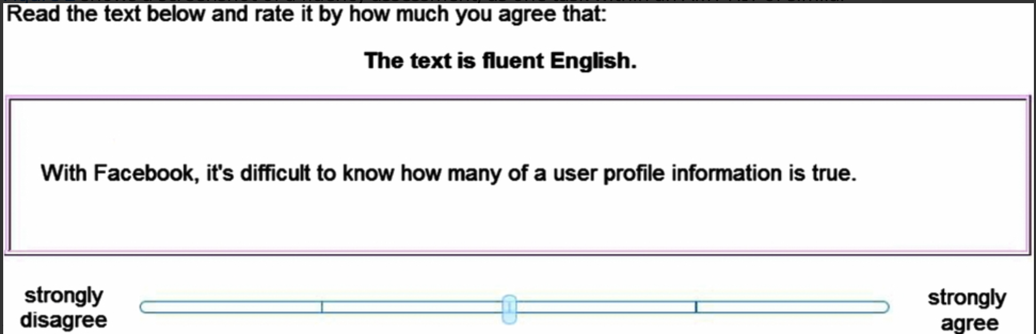
Annotation Tool (WMT)

Slide 37
Running Example
Reference:
  Israeli officials are responsible for airport security
Machine Translation:
  Israeli officials responsibility of airport safety
What score should this get?

Slide 38
But "airport are for Israeli officials responsible security" has an F of 100%!

Slide 39
BLEU
N-gram overlap between machine translation output and reference translation(s)
Compute precision for n-grams of size 1-4
Take the geometric mean (multiply together, take 4th root)
Add brevity penalty for too short translations
  Otherwise, you could maximize score by finding one perfect 4-gram and ignoring the rest of the sentence
Typically calculated over entire corpus, not single sentence

Slide 40
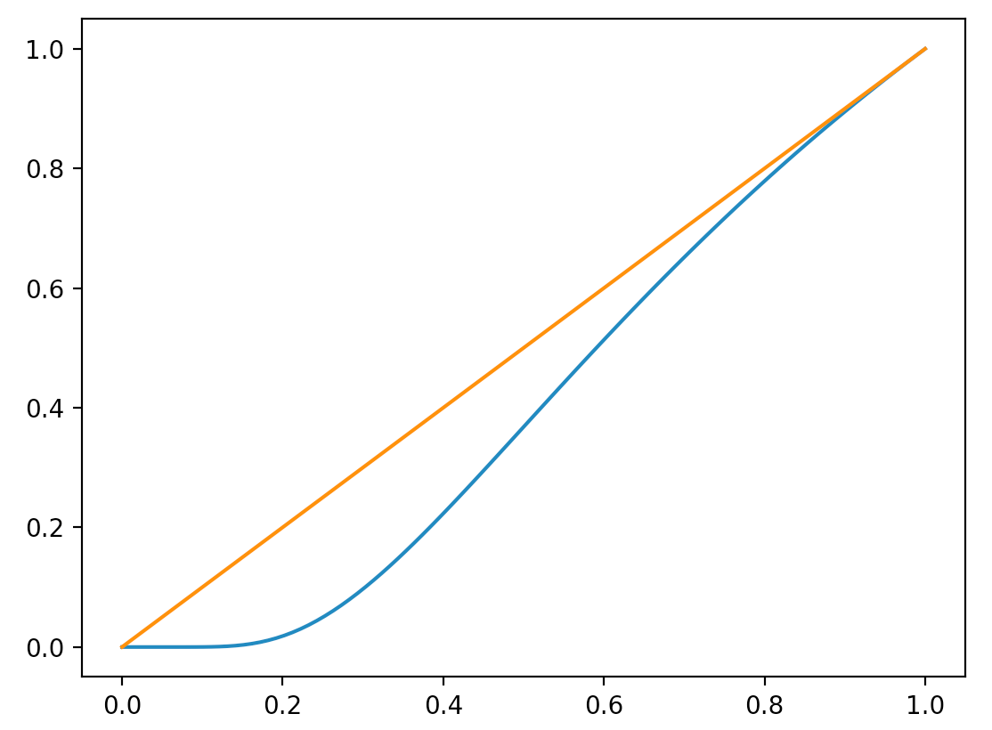
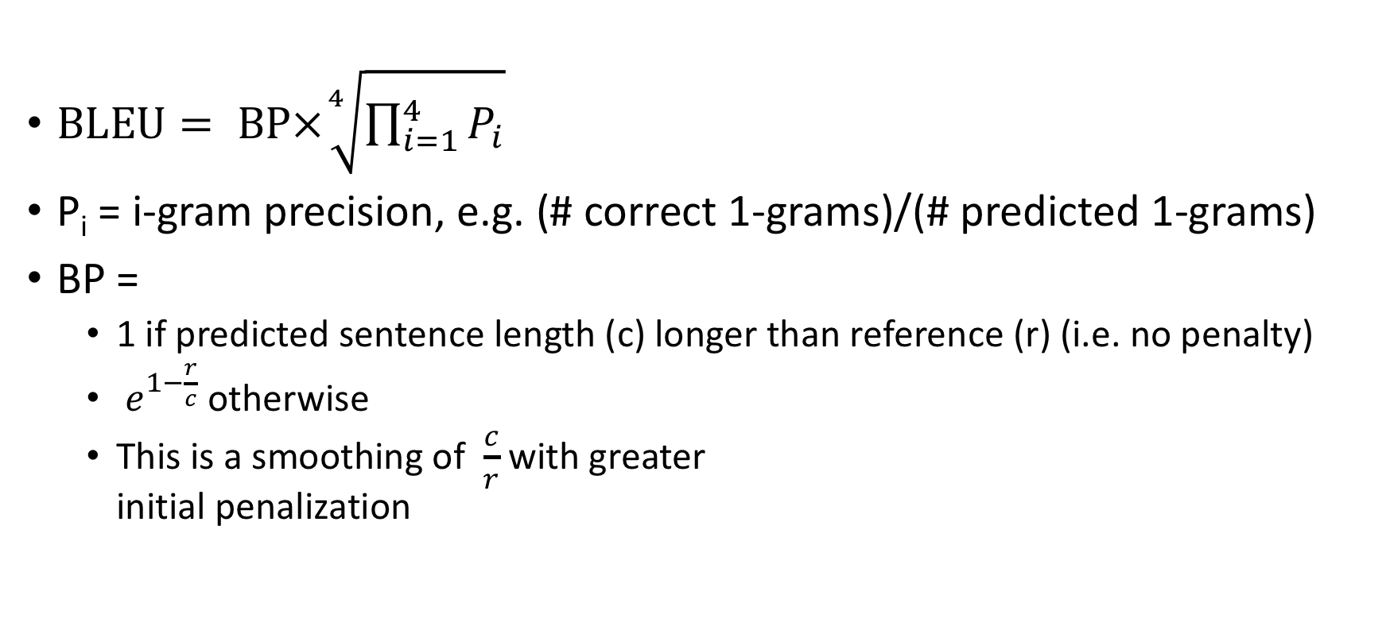
BLEU
$\text{BLEU}= \text{BP}×\sqrt[4]{\prod_{i=1}^{4}{P_{i}}}$
P_{i} = i-gram precision, e.g. (# correct 1-grams)/(# predicted 1-grams)
BP =
  1 if predicted sentence length (c) longer than reference (r) (i.e. no penalty)
  $e^{1−\frac{r}{c}}$ otherwise
  This is a smoothing of $\frac{c}{r}$ with greater
  initial penalization

Slide 41
Historical Notes: Why is it called BLEU?
Invented at IBM
Backronym: "BiLingual Evaluation Understudy"
  Ugh: two acronym violations (mid-word, forced term)
  But the name stuck!
Later on, at ISI, “ROUGE (Recall Oriented Understudy for Gisting Evaluation)” was invented – basically a Recall-based version of BLEU. Originally for summarization, but sometimes used for MT.
In conclusion, NLP researchers really like parody/are uninventive
  See also muppet tendencies, “Frustratingly Easy X”, “Language models are X”

Slide 42
Example
Input Foreign Sentence:
  <DOESN'T MATTER!>
"Gold" Reference Sentence:
  Israeli officials are responsible for airport security
MT System A Output:
  Israeli officials responsibility of airport safety
MT System B Output:
  airport security Israeli officials are responsible

Slide 43
BLEU walkthrough
Israeli officials are responsible for airport security | 1-gram prec | 2-gram prec | 3-gram prec | 4-gram prec | geometric mean | length ratio c/r | length penalty e^(1-r/c)
Israeli officials responsible of airport safety | 4 / 6 | 1 / 5 | 0 / 4 | 0 /3 | 0 | 6 / 7 | .846
airport security Israeli officials are responsible | 6 / 6 | 4 / 5 | 2 / 4 | 1 / 3 | .604 | 6 / 7 | .846
the the the the the the the | 0 / 7 | 0 / 6 | 0 /5 | 0 /4 | 0 | 7 / 7 | 1
officials are responsible for | 4/4 | 3/3 | 2/2 | 1/1 | 1 | 4/7 | .472
BLEU
0
.511
0
.472

Slide 44
BLEU Best Practices
Score over a corpus of sentences, not a single sentence
  Low chance of zero 4-gram matches; which leads to 0 BLEU
 | 1g match | 1g hyp | 2g match | 2g hyp | 3g match | 3g hyp | 4g match | 4g hyp | ref len
s1 | 8 | 23 | 3 | 22 | 1 | 21 | 0 | 20 | 21
s2 | 11 | 13 | 7 | 12 | 5 | 11 | 3 | 10 | 17
bleu
0
0.374444196
SUM | 19 | 36 | 10 | 34 | 6 | 32 | 3 | 30 | 38
0.219718129

Slide 45
BLEU Best Practices
 | 1g match | 2g match | 3g match | 4g match
1 ref | 3 | 1 | 0 | 0
4 ref | 5 | 2 | 0 | 0
Use multiple references, when available
  allows synonyms, rephrasing
  expensive to create
Hyp:
  Israeli officials responsibility of airport safety
Ref
  Israeli officials are responsible for airport security
More refs
  Israel is in charge of the security at this airport
  The security work for this airport is the responsibility of the Israeli government
  Israeli side was in charge of the security of this airport

Slide 46
More Refs mean recall is a bad idea
Recall = # correct n-grams / # reference n-grams
But consider this reference set:
  I always do
  I invariably do
  I perpetually do
Which one of these hypotheses is better?
  I always do
  I always invariably perpetually do

Slide 47
A competing approach: METEOR
Compare hypothesis and single reference
  If more than one reference, use reference that gives highest score
Align matching words
  extension: allow synonym, paraphrase, stems to match
Calculate balanced F-measure: F = PR/(αP+(1-α)R)
Penalize by number of "chunks" = uninterrupted reference coverage
  penalty = 0.5*(chunks/unigram_match)
Meteor=F*(1-penalty)
P = 4/6
Israeli officials are responsible for airport security
R = 4/7
Israeli officials responsible of airport safety
with α = .9, F = (16/42)/(.9*4/6)+(.1*4/7) = .3809/(.6+.0571) = .580
chunks = 3; penalty = .5*(3/4) = .375
METEOR = .580*(1-.375) = .3625
Notes:
chunk penalty rewards high ngram. E.g. If you match 3 of 6 words, if every other word matches, you get ½ your F measure. But if the first 3 words match you get 5/6 your F measure: 1- (1*.5) = .5 vs. 1 – (1/3 * .5) = 5/6.

Slide 48
METEOR worked examples
P = 4/6
Israeli officials are responsible for airport security
R = 4/7
Israeli officials responsible of airport safety
with α = .9, F – (16/42)/(.9*4/6)+(.1*4/7) = .3809/(.6+.0571) = .580
chunks = 3; penalty = .5*(3/4) = .375
METEOR = .580*(1-.375) = .3625
P = 6/6
Israeli officials are responsible for airport security
R = 6/7
airport security Israeli officials are responsible
with α = .9, F – (36/42)/(.9*1)+(.1*6/7) = .8571/(.9+.0857) = .870
chunks = 2; penalty = .5*(2/6) = .167
METEOR = .870*(1-.167) = .725
 | BLEU | METEOR
S1 | 0 | .3625
S2 | .511 | .725

Slide 49
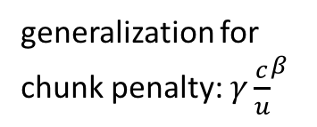
METEOR also allows flexible matching
content vs
function word split
generalization for
chunk penalty: $γ{\frac{c}{u}}^{β}$
inflection
Jim went home
Joe goes home
Jim walks home
synonym
How much credit? What counts as a match?
Depends on the version of METEOR you're using
This is why I believe METEOR didn't catch on as well as BLEU

Slide 50
METEOR vs BLEU
METEOR calculates precision and recall, so only one reference can be used
  If multiple references, take the one that gives highest score
  Can't use half of one reference, half of another
METEOR is a per-sentence metric
  Good for certain kinds of optimization
  There are single-sentence BLEU approximations
METEOR has semantic similarity-based matching
  target language-dependent resources are needed
  lots of small details regarding how to apply this; hampered METEOR's growth

Slide 55
Model-Based Evaluation Methods
Examples: BLEURT (2020), RUSE (2018), YiSi (2019)
Basic idea = Train a model to predict human preference -- that should correlate well with human preference!
BLEURT synopsis:
  BERT fine-tuned to regress to human judgement (loss is mean squared error)
  Since there isn’t a lot of that, pre-train on other signals
    predict BLEU
    predict ROUGE
    approximate translation score as backtranslation score
  Beats a lot of other metrics
It’s still something of a biased black box...e.g. for a sentence with reference “You must be a doctor”, the error “He must be a doctor” is preferred over “She must be a doctor”.
Lately: Can ask GPT-4 “Give me a score” (research problem: what data sets has it already seen?

Slide 56
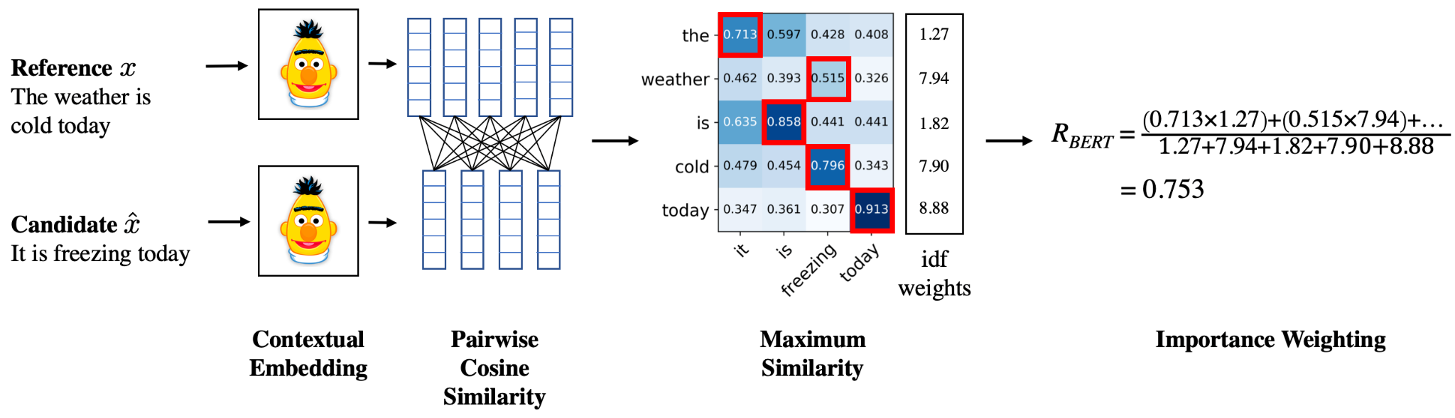
Embedding-based Evaluation
Unsupervised calculation based on embedding similarity
e.g. BERTScore (Zhang et al. 2019)
Notes:
recall along the rows, or precision along the columns. use IDF to encourage rarer more contentful terms

Slide 57




Regression-based Evaluation
Supervised training of an embedding-based regressor
e.g. COMET (Rei et al. 2020)
0.5
Source
0.4
Difference
Update
Reference
0.1
??
Hypothesis 1

Slide 58
2011 WMT Evaluation Metrics results

Slide 59
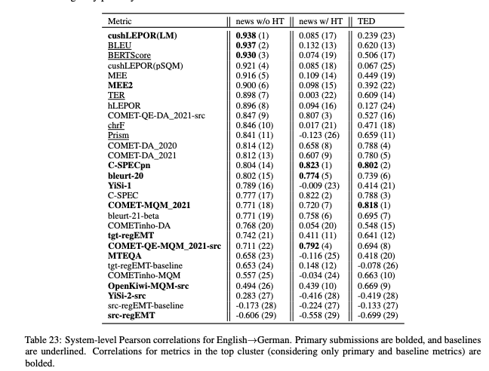
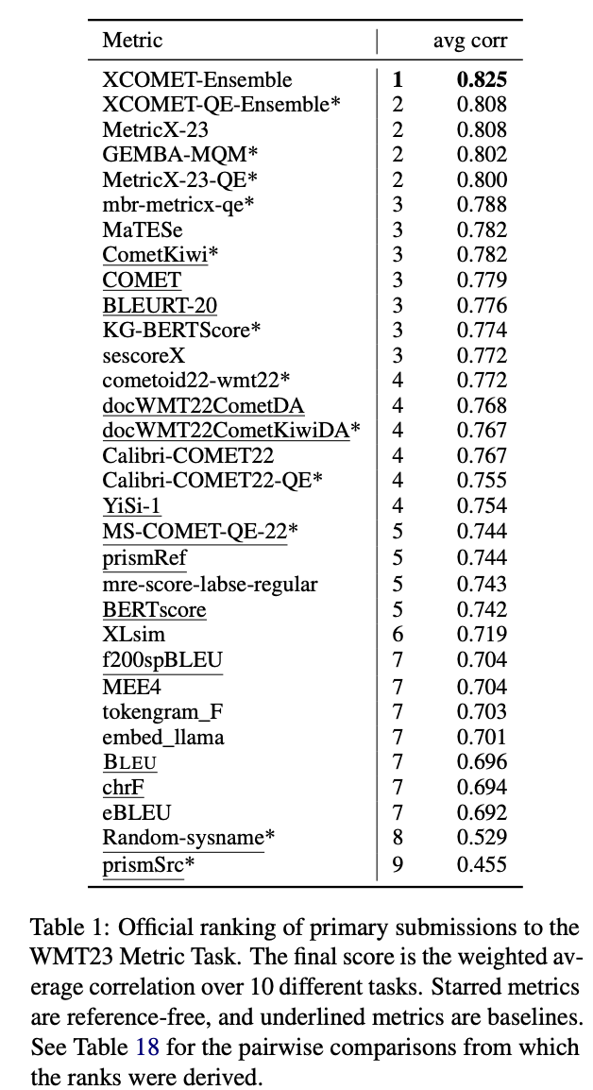
2022

Slide 60
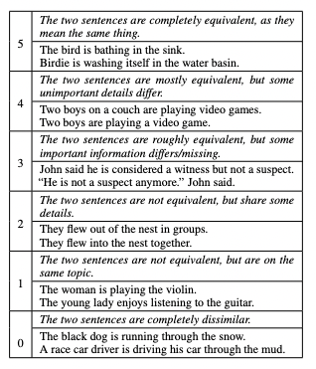
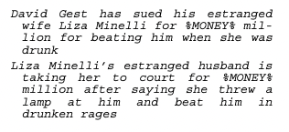

This all comes down to sentence similarity!
STS-B: Collection of pairs with
five-point human ranking:
MSRP: Heuristically extracted
and human-judged pairs (binary)
Similar to MSRP: Quora, PAWS
Katz was born in Sweden in 1947 and
moved to New York City at the age of 1.
Katz was born in 1947 in Sweden and
moved to New York at the age of one.
Can a good person become bad?
Can a bad person become good?
X
Notes:
paws = paraphrase adversaries from word scrambling

Slide 61
 |  | STS-B |  |  | Paraphrase
 |  | All (1379) | Hard 20% (146) | Hard 10% (24) | MSRP |  | Quora |  | PAWS
 |  |  |  |  | Random | Hardest | Random | Hardest | Random | Hardest
METEOR |  | 0.5560 | -0.5263 | -0.7377 | 0.710 | 0.500 | 0.725 | 0.500 | 0.615 | 0.500
BERTScore |  | 0.5937 | -0.4265 | -0.7253 | 0.790 | 0.500 | 0.745 | 0.500 | 0.700 | 0.500
MoverScore |  | 0.6676 | -0.1553 | -0.2530 | 0.760 | 0.500 | 0.730 | 0.500 | 0.645 | 0.500
QA-eval |  | 0.6218 | 0.5706 | 0.6763 | 0.640 | 0.520 | 0.680 | 0.535 | 0.825 | 0.740
BLEURT |  | 0.7308 | 0.3056 | 0.5789 | 0.750 | 0.500 | 0.765 | 0.500 | 0.645 | 0.505
MIS (new) |  | 0.7710 | 0.7110 | 0.9751 | 0.760 | 0.570 | 0.870* | 0.740* | 0.830 | 0.765
Embedding | SBERT | 0.8404 | 0.7748 | 0.9449 | 0.690 | 0.500 | 0.815 | 0.500 | 0.630 | 0.535
 | ada | 0.8439 | 0.6813 | 0.8405 | 0.720 | 0.500 | 0.805 | 0.500 | 0.650 | 0.510
 | SGPT | 0.8545 | 0.7288 | 0.8188 | 0.740 | 0.500 | 0.790 | 0.500 | 0.675 | 0.505
GPT (LLM) Prompting | davinci | 0.7756 | 0.7617 | 0.8549 | 0.770 | 0.700 | 0.765 | 0.510 | 0.680 | 0.680
 | 3.5-turbo | 0.5294 | 0.4204 | 0.6729 | 0.640 | 0.565 | 0.710 | 0.500 | 0.760 | 0.690
 | GPT-4 | 0.8669 | 0.8529 | 0.9022 | 0.790 | 0.735 | 0.835 | 0.510 | 0.840 | 0.785
 | LLaMA-2 | 0.6903 | 0.7903 | 0.8430 | 0.620 | 0.540 | 0.720 | 0.515 | 0.715 | 0.625
GPTScore | ada | 0.5559 | -0.1276 | 0.1660 | 0.695 | 0.500 | 0.685 | 0.500 | 0.625 | 0.500
 | babbage | 0.5972 | 0.1329 | 0.6559 | 0.695 | 0.500 | 0.725 | 0.500 | 0.680 | 0.500
 | curie | 0.6435 | 0.2503 | 0.7790 | 0.675 | 0.500 | 0.745 | 0.500 | 0.675 | 0.500
 | davinci | 0.6380 | 0.4288 | 0.8685 | 0.665 | 0.500 | 0.705 | 0.500 | 0.680 | 0.505
 | LLaMA-2 | 0.4389 | 0.0776 | 0.2968 | 0.660 | 0.500 | 0.650 | 0.500 | 0.555 | 0.505

Slide 62
Automated Metrics: Conclusions
Essential tool for system development
Not fully suited for ranking systems of different types
BLEU: dominant metric
  easy to calculate
  not good for single-sentence scores
METEOR: also popular
  various versions try to do different kinds of approximate matching
Model-based metrics more en vogue, but have their own issues
Evaluation metrics still an open challenge

Slide 63
Pre-Neural Statistical MT (1989-2014)
Use EM to find word alignments of parallel sentences
Break sentences up into phrase pair chunks
Extract feature values for each chunk and optimize weights to maximize BLEU on development set
Problems:
  Translations are often not that fluent (looks like a ransom note)
  Which features to choose? How to combine?
  Fairly complicated noisy pipeline

Slide 64
Not that Fluent...
Source : ප්‍රවාහන ගාස්තු ඉහළ නැංවීමට විරෝධය පළ කරමින් බ්‍රසීලයේ අද (07) විරෝධතා ක්‍රියාත්මක වුණා.
Ref0 : There were protests in Brazil today (07) due to price increases in transportation.
mt1 : Today (07), Brazil was to protest against the bus fare increase.
mt2 : Staged a protest against transport fares to increase in Brazil, launched a protest today (07th).
mt3 : Transport fare increase in Brazil to protest against the government today the implementation of the protests.

Slide 65
Features
N-gram language model (2 or more)
Phrase translation probabilities p(e|f) and p(f|e)
Word translation probabilities p(e|f) and p(f|e)
Number of Insertion/deletions (when phrases include unaligned words)
Number of phrases used
Length of hypothesis
Amount of jumping around
Lexical flag features (binary value for "sentence contains 'octopus'")

Slide 66
Pipeline
Word alignment
Phrase pair extraction
Feature Estimation
Parameter Estimation
Wrong alignment? Stuck!
Can only use the phrase
pairs you extracted; can't
arbitrarily generate words
What are the right features
for this data set? (may
vary from set to set)
Typically adjusted over a
small set; hard to search
efficiently

Slide 67
Problems
Are these the right features? Should we use combinations of features?
What if we made a mistake during alignment? We're locked into those possibilities even though we didn't make alignments to optimize mt quality.
We only have estimates for the things we've seen and based on limited context. It would be nice to generalize to unseen events and full context
NMT solved all of this
  first with FFNN LMs
  then with LSTMs
  then with attention
  and then with transformers

Slide 68
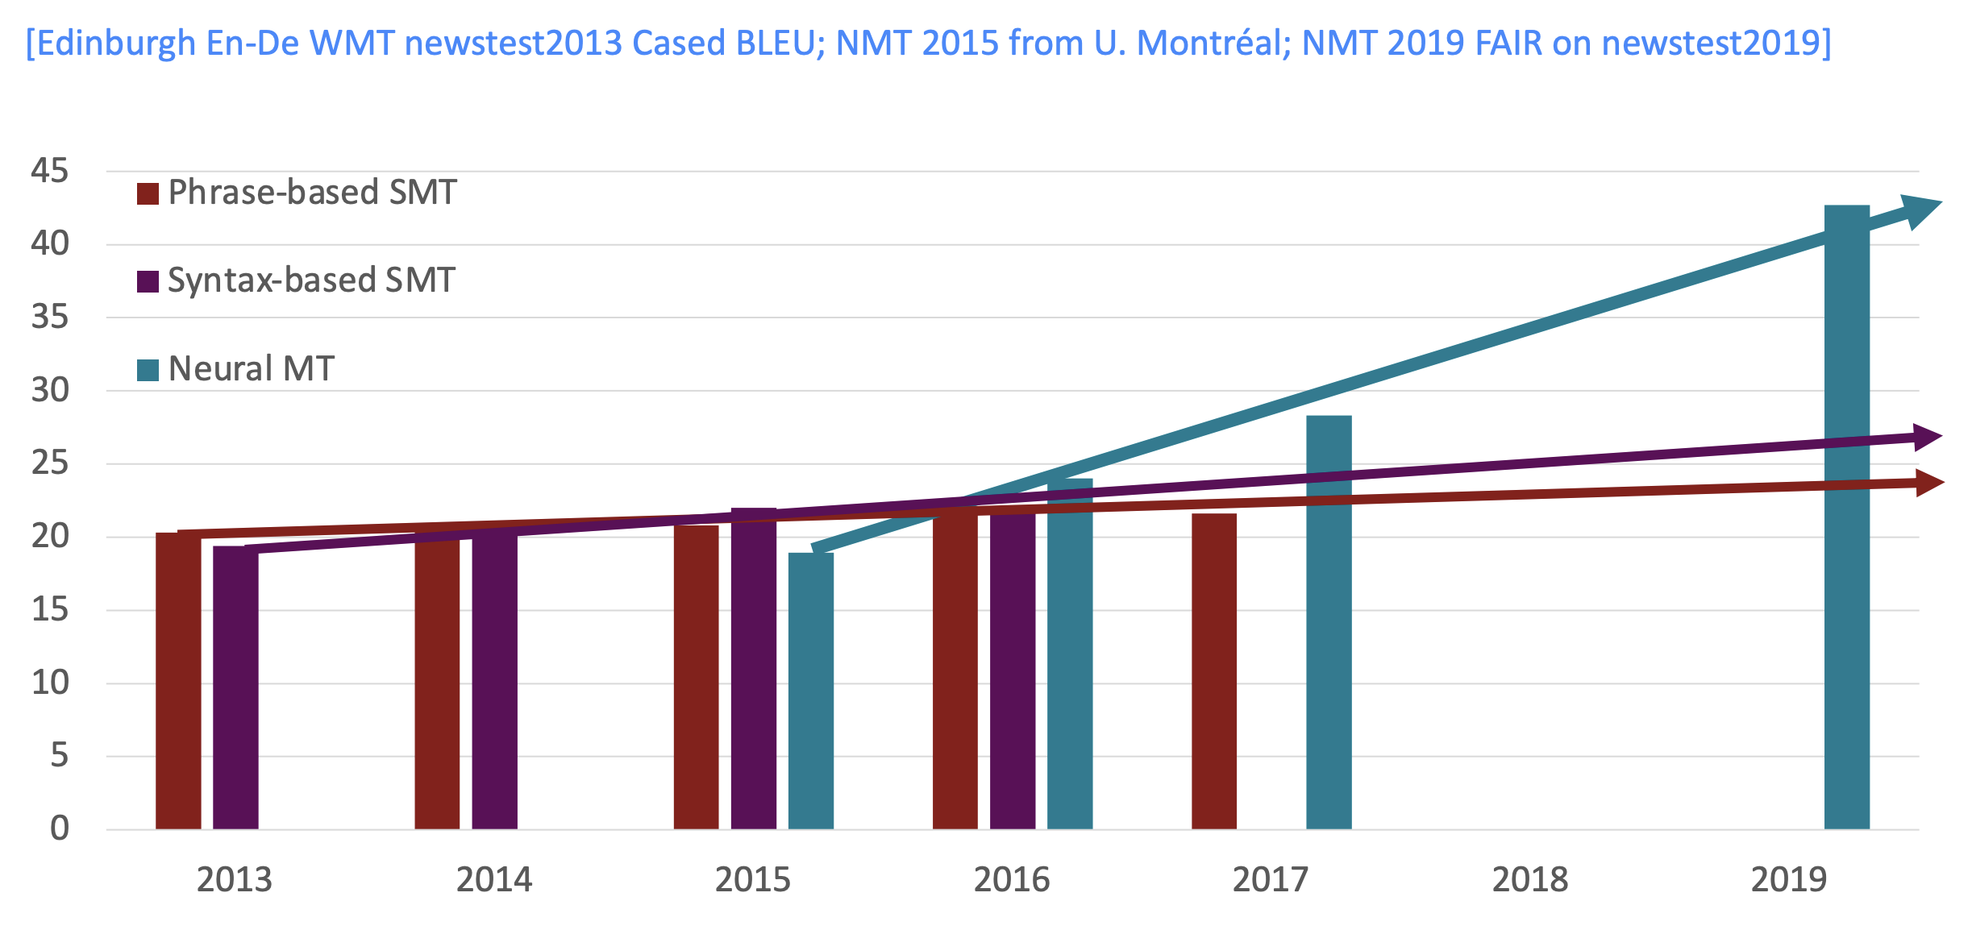
Progress in MT over Time

Slide 70
And this is before transformers!

Slide 71
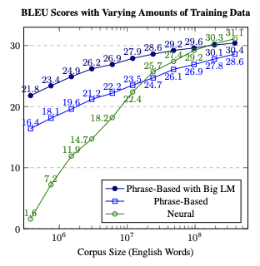
Koehn Knowles 2017
Thamme Gowda thesis defense (2022)

Slide 72
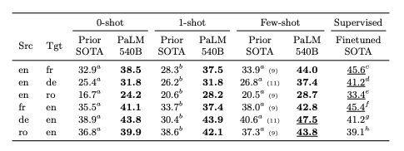
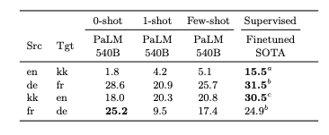
LM as translation?
PaLM (2022) – big transformer LM
no parallel data but really good xlation!
how?

Slide 73
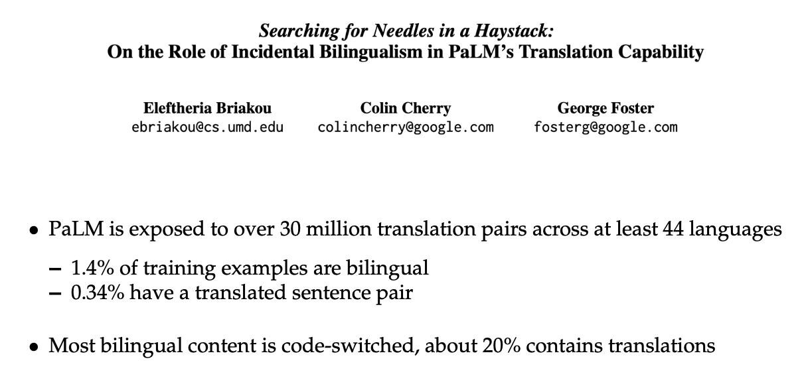
Hard to avoid leaks!
from philipp koehn

Slide 74
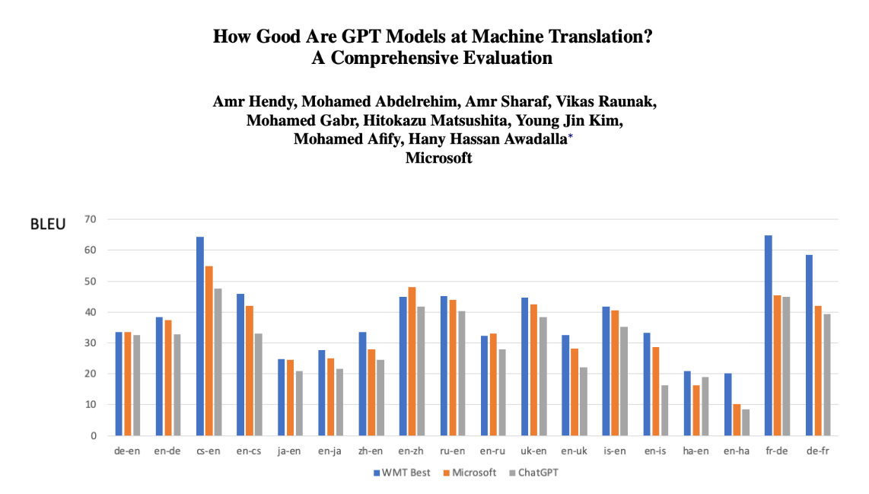
from philipp koehn

Slide 75
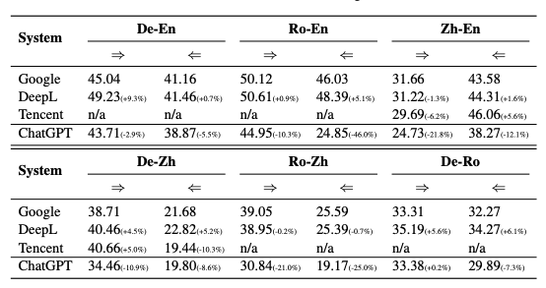
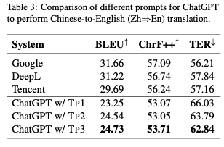
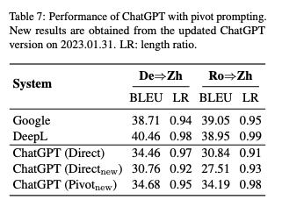
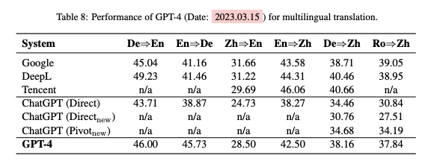
More Recent, and with GPT4
Is ChatGPT A Good Translator? Yes With GPT-4 As The Engine (jiao et al 23)

