Slide 1
Planning with LLM Agents
Tenghao Huang
Department of Computer Science
Some slides borrowed from Frank Xu

Slide 2



About me
Third-year PhD Candidate at USC
Research interests: Language Agents, IR, Planning
Notes:
Here is some info about myself.

Slide 3

01
Background
Contents
02
Introduction
03
Planning Scenarios
04
Learning Approaches
05
Evaluation
06
Application
Notes:
Here is a brief outline for today’s presentation.
I will first introduce the background of this API shortlisting.
Then we will dive into task definition, dataset and proposed method.
Last but not least, I will highlight some preliminary results and future direction.

Slide 4
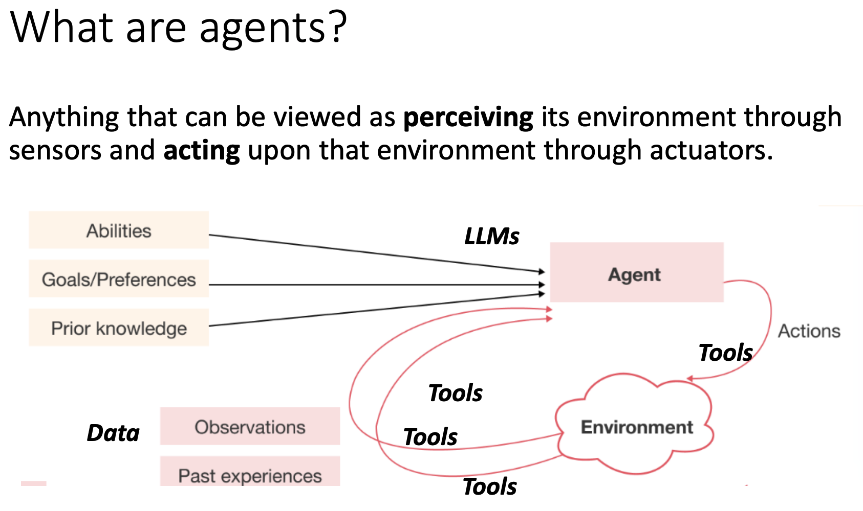
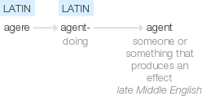
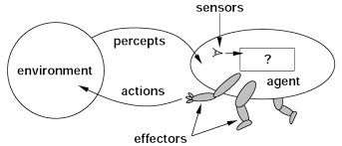
Background

Slide 5
Background

Slide 6
Background
Why Agents? 🤔

Slide 7
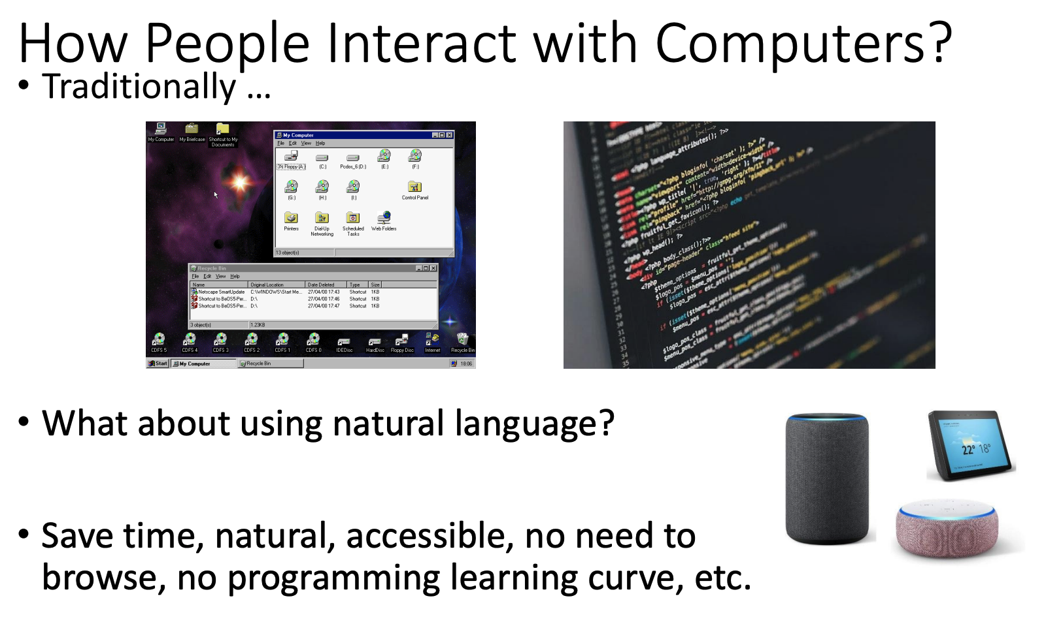
Background

Slide 8
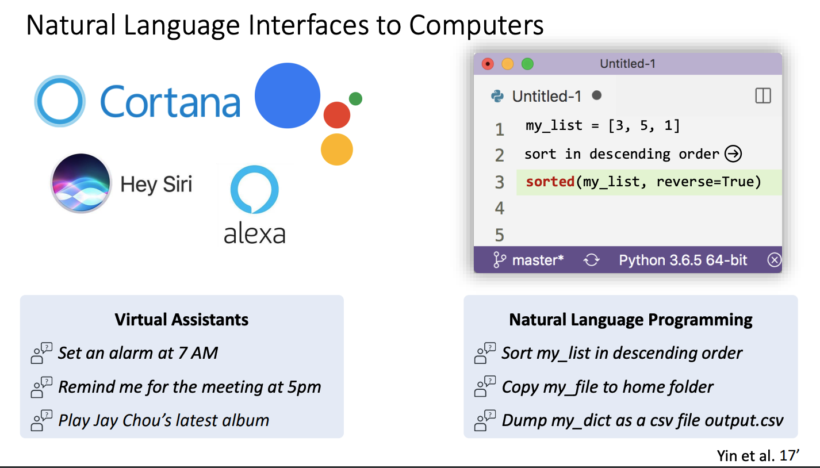
Background

Slide 9
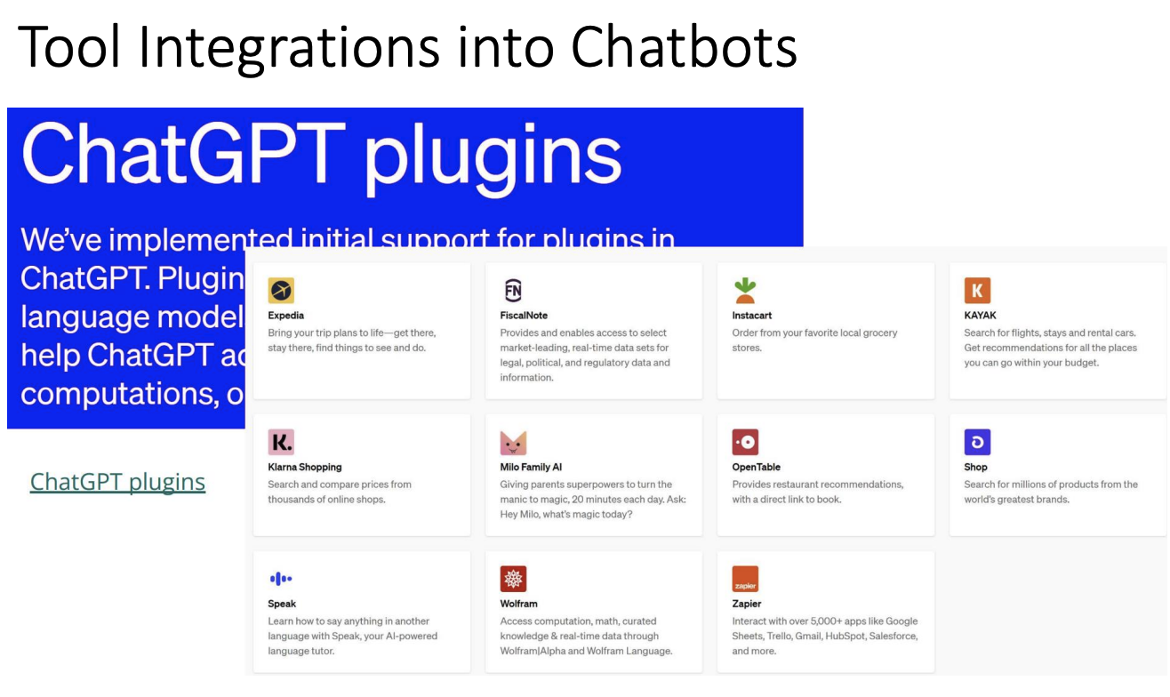
Background

Slide 10
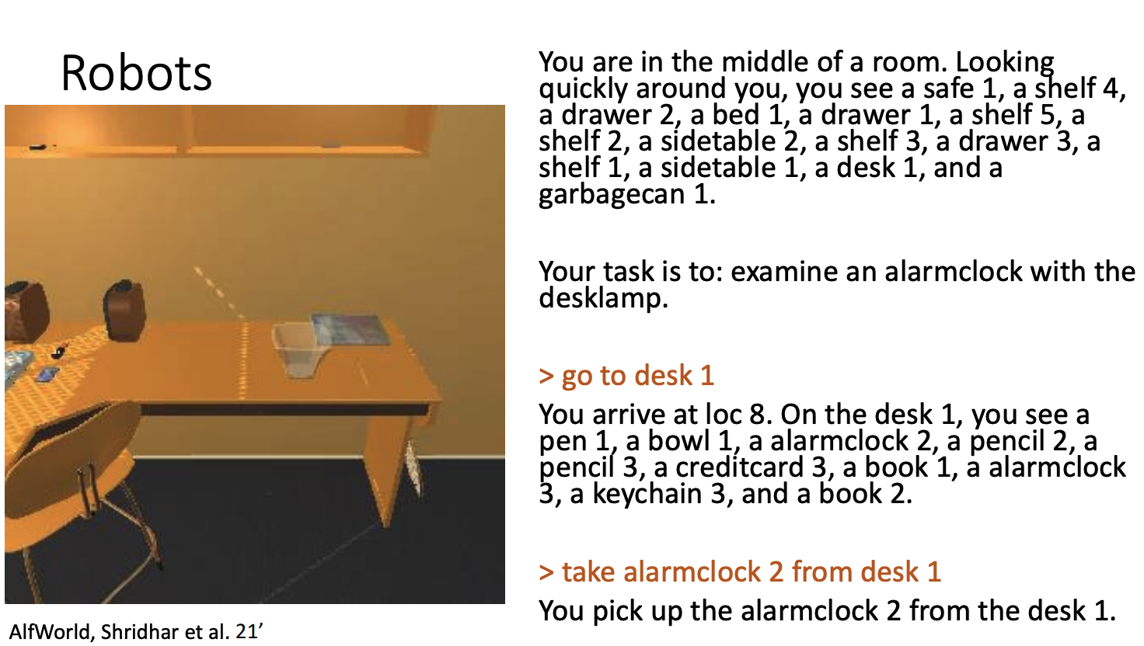
Background

Slide 11
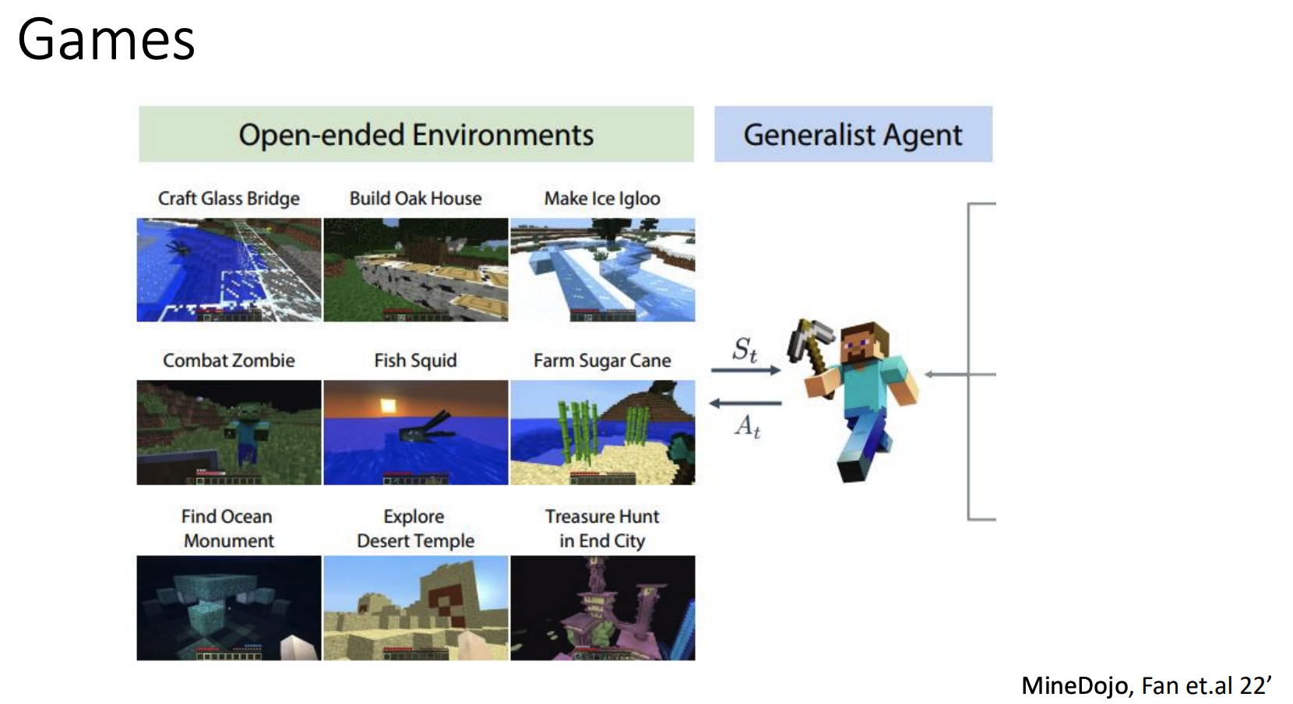
Background

Slide 12
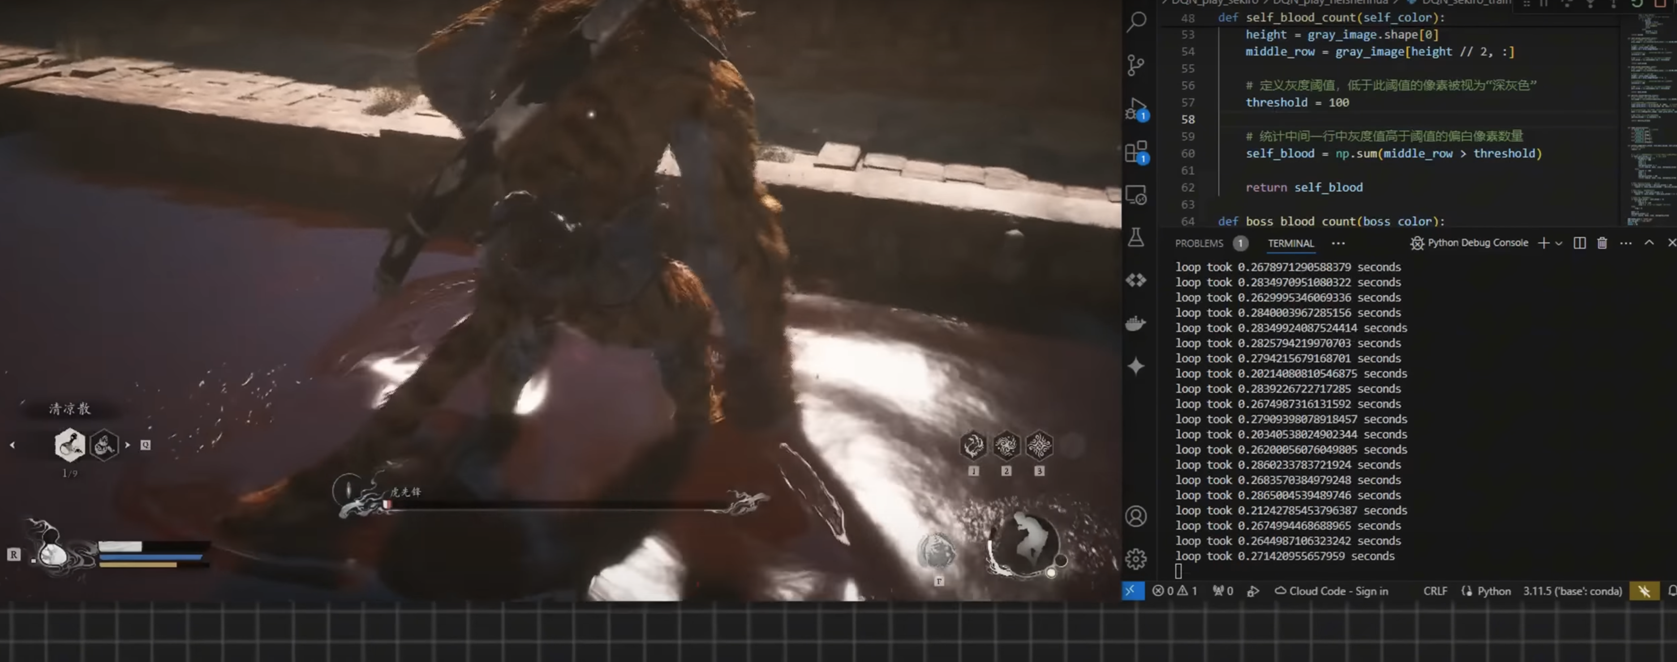
Background
Games
https://www.youtube.com/watch?v=ajUeHzJuzoY

Slide 13

Background
Planning: The algorithmic determination of a sequence of actions, based on a model of the environment and the robot's capabilities, intended to achieve predefined goals or tasks.

Slide 14




The Planning Scenarios with Agents
Web-agent
Creative Writing
Tool Learning
Low-data
Partial-data
High-data
Little-to-no end-states or intermediate action states is available about the planning process.
End state information, but no actions, are available to the planning process.
Pre-final text and/or action sequences are available for the models to train on.

Slide 15
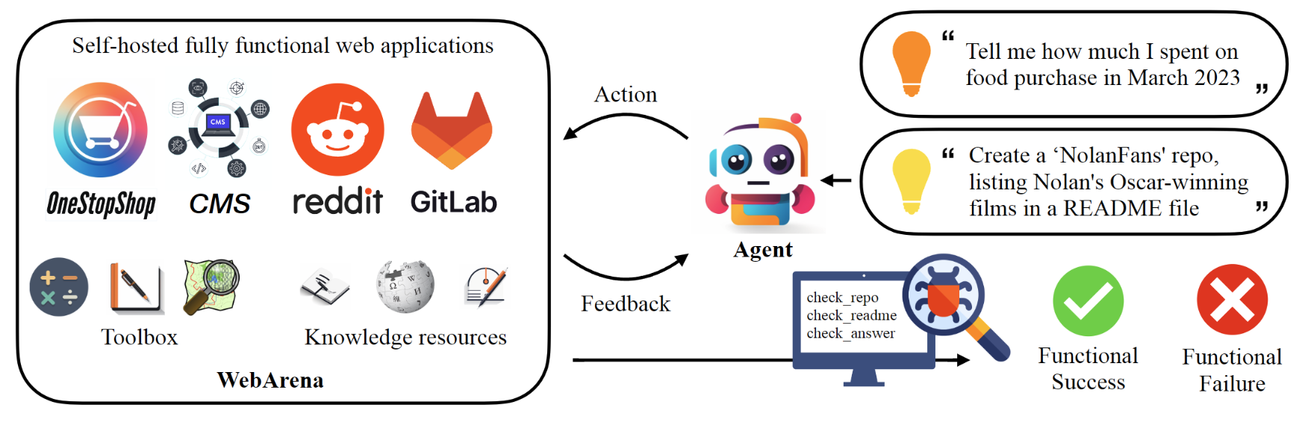
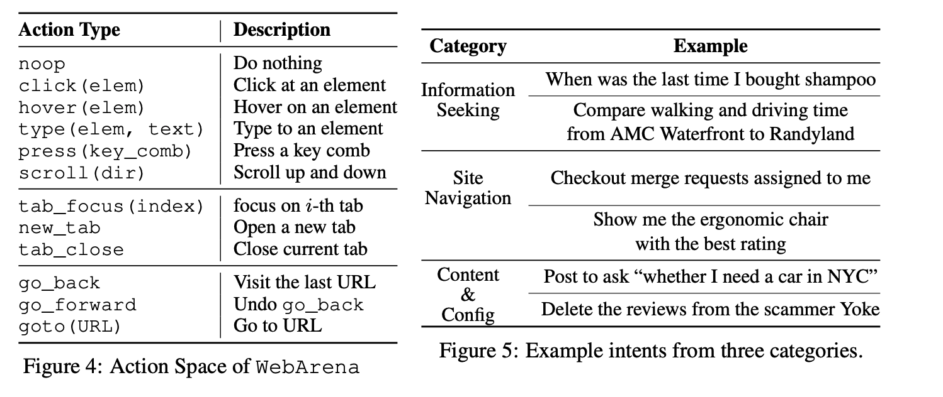
The Planning Scenarios – Web Agent
Web-agent
Low-data
Little-to-no end-states or intermediate action states is available about the planning process.
Zhou et al. 2024

Slide 16
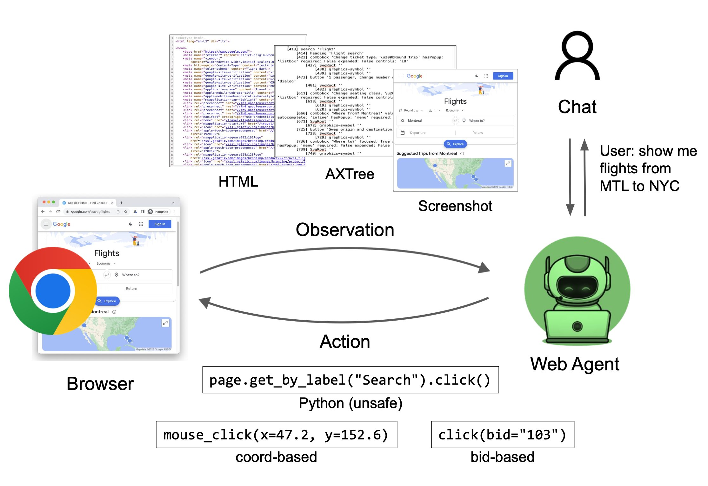
The Planning Scenarios – Web Agent
Zhou et al. 2024

Slide 17
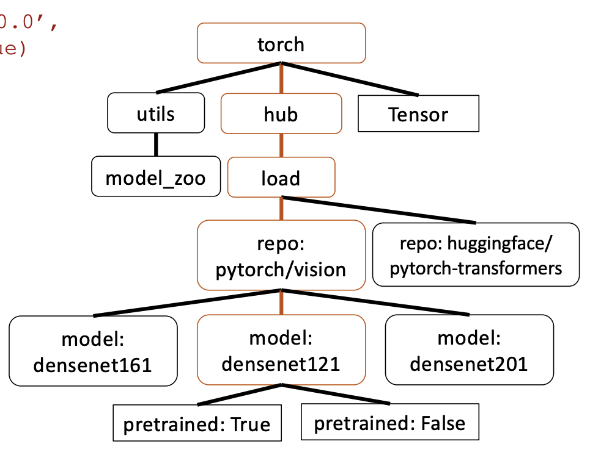
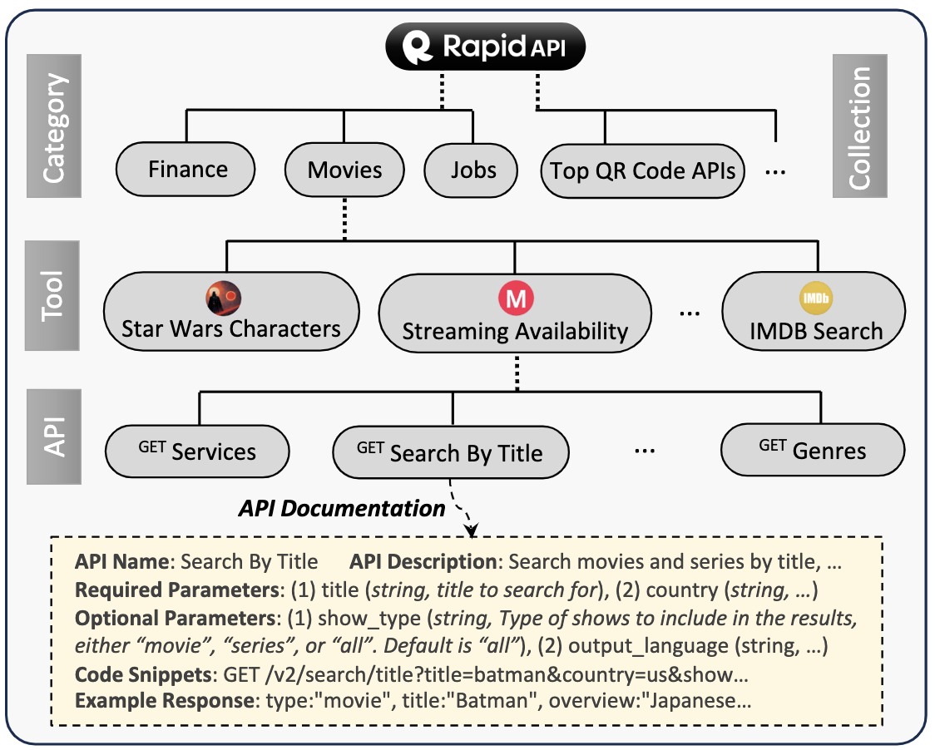
The Planning Scenarios – Tool Agent
Tool Learning
High-data
Pre-final text and/or action sequences are available for the models to train on.
Patil et al. 2023
Qin et al. 2023

Slide 18
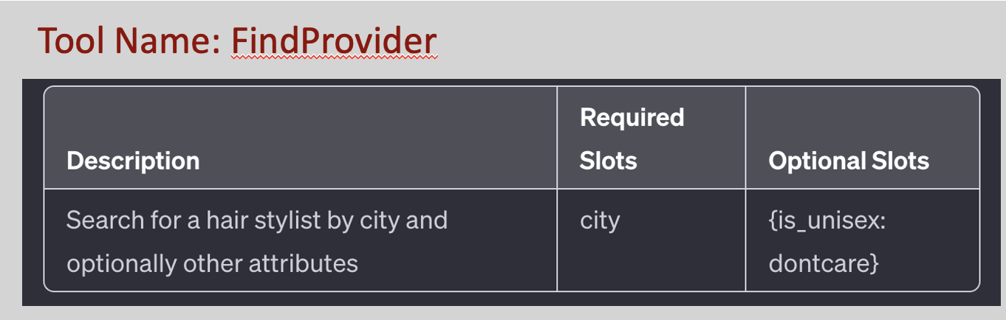


The Planning Scenarios – Tool Agent
API shortlisting: Given a simple user query $q$ and a set of API functions $A=\left\{a_{1​},a_{2​},…, a_{n​}\right\}$, the shortlisting task is to retrieve top-$k$ APIs that are the most relevant to the user query $q$.
APIs
Book me a restaurant in Seattle.
Relevant APIs
Restaurant
Book Cab
…
Reservation
Qin et al. 2023

Slide 19
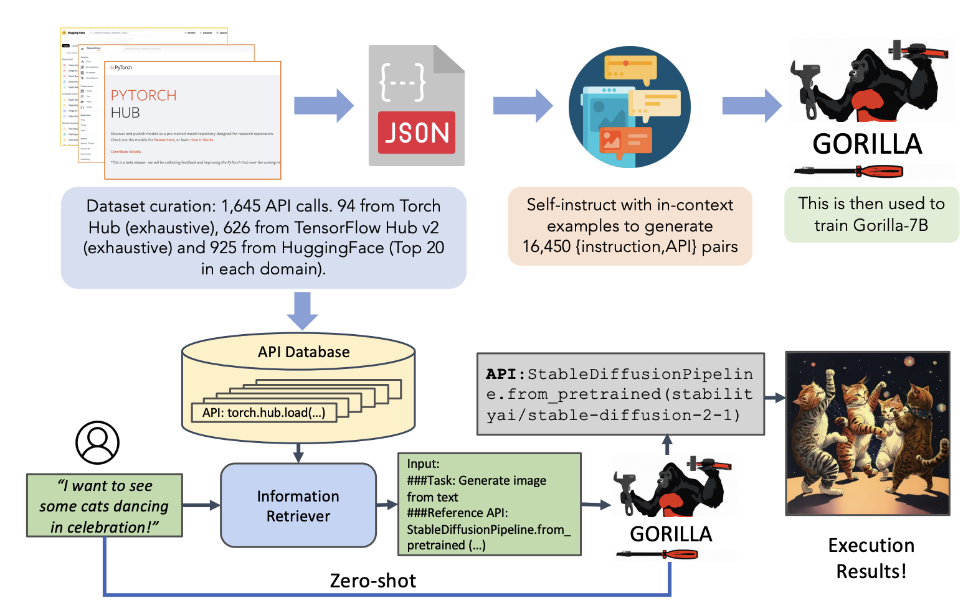
The Planning Scenarios – Tool Agent
Patil et al. 2023

Slide 20
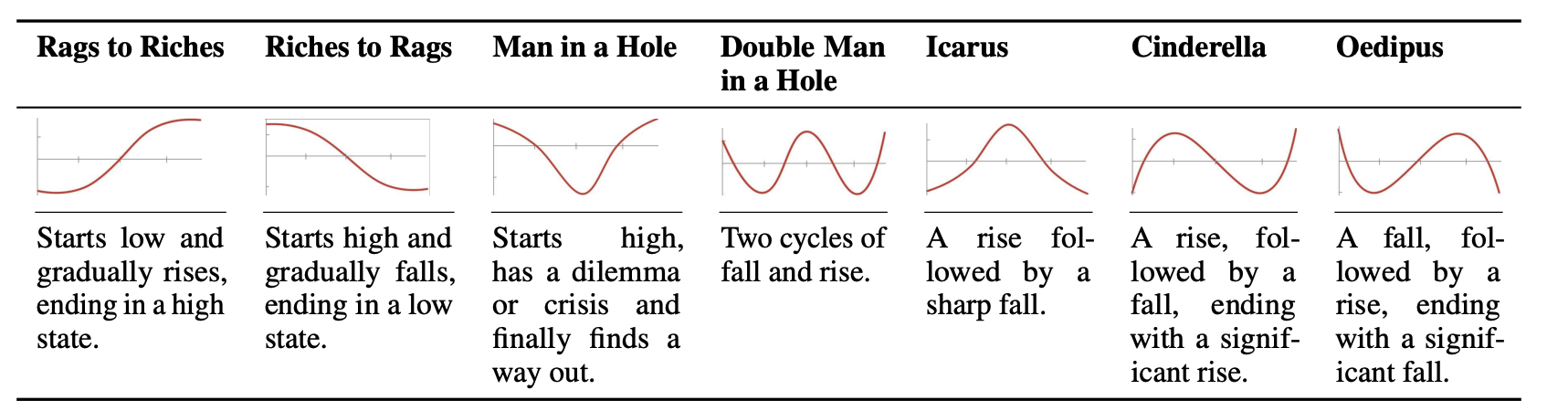
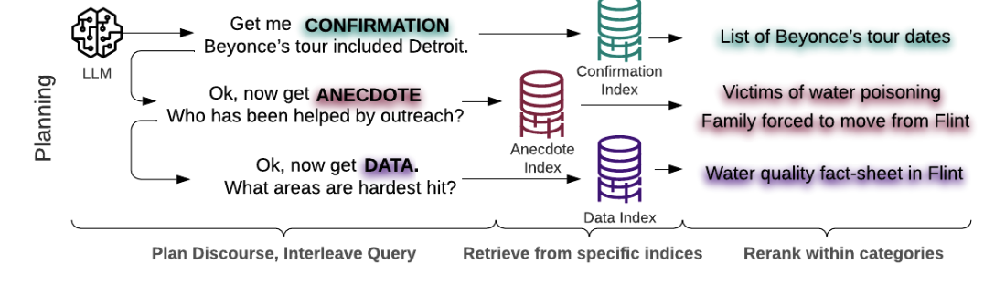
The Planning Scenarios – Creative Writing
Creative Writing
Tian et al. 2024
Spangher et al. 2024
Partial-data
End state information, but no actions, are available to the planning process.

Slide 21
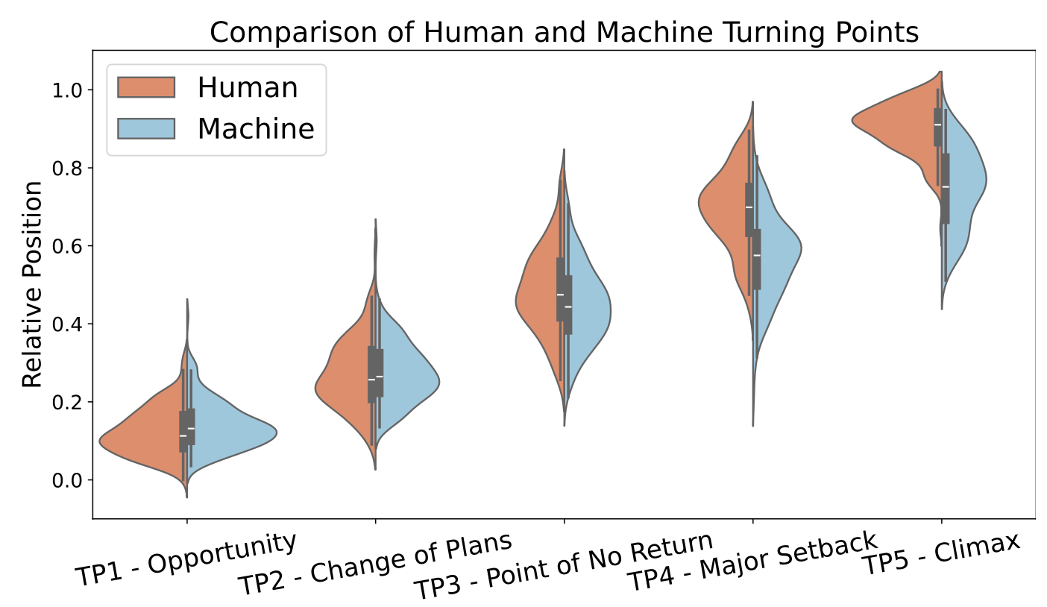
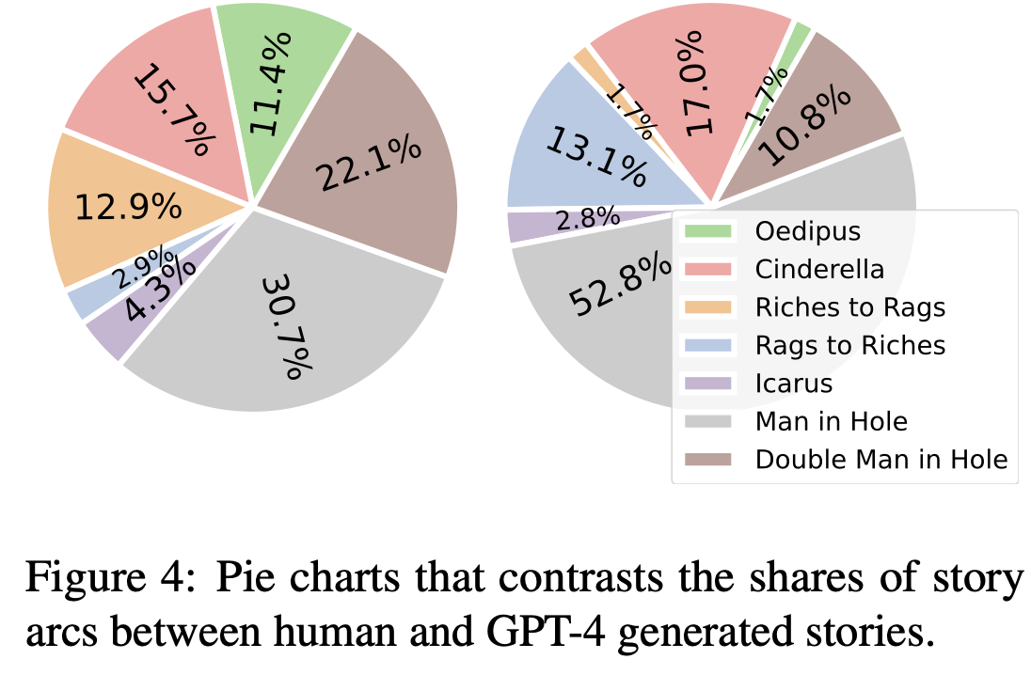
The Planning Scenarios – Creative Writing Agent
Are Large Language Models Capable of Generating Human-Level
Narratives?
Tian et al. 2024

Slide 22
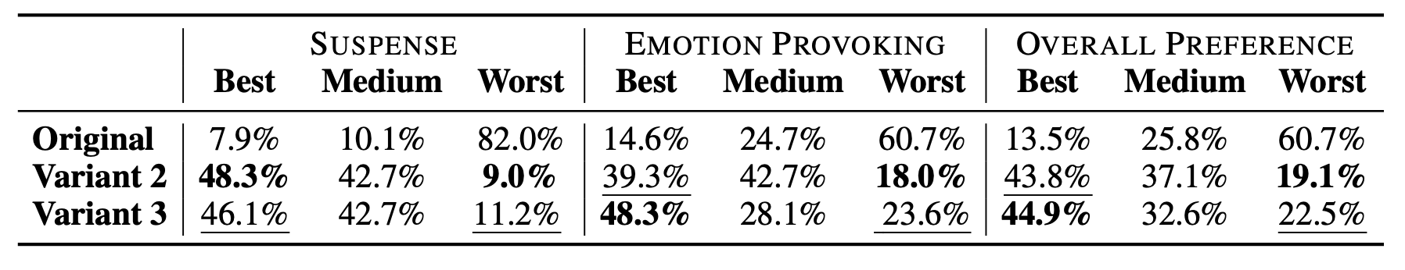
The Planning Scenarios – Creative Writing Agent
Are Large Language Models Capable of Generating Human-Level
Narratives?
Tian et al. 2024

Slide 23
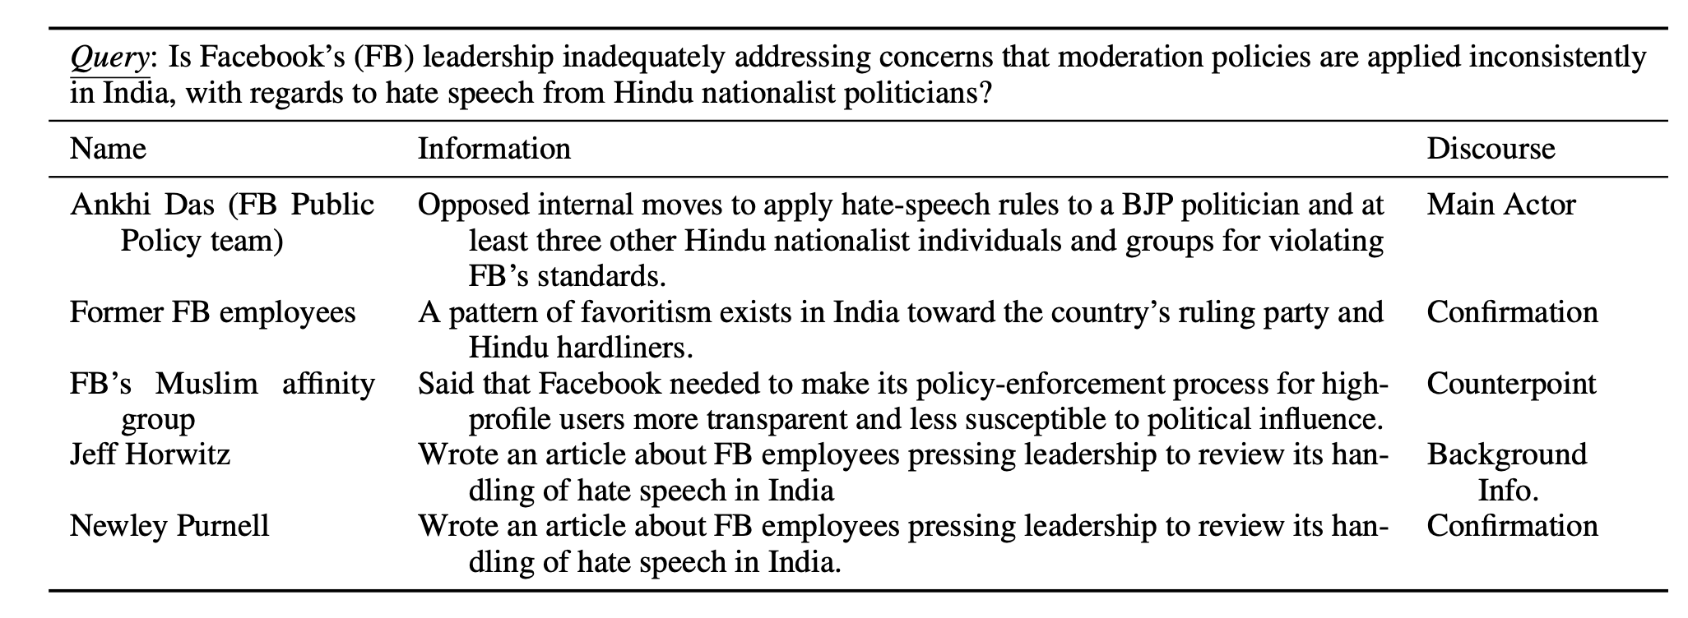
The Planning Scenarios – Creative Writing Agent
Task
Spangher et al. 2024

Slide 24
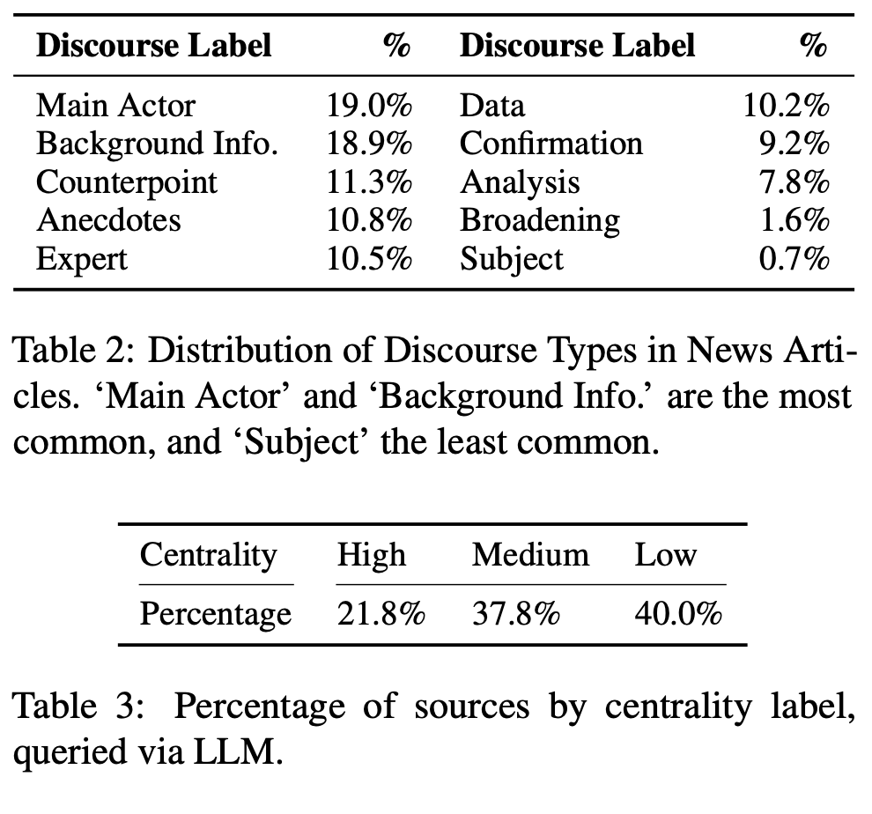
The Planning Scenarios – Creative Writing Agent
Spangher et al. 2024

Slide 25
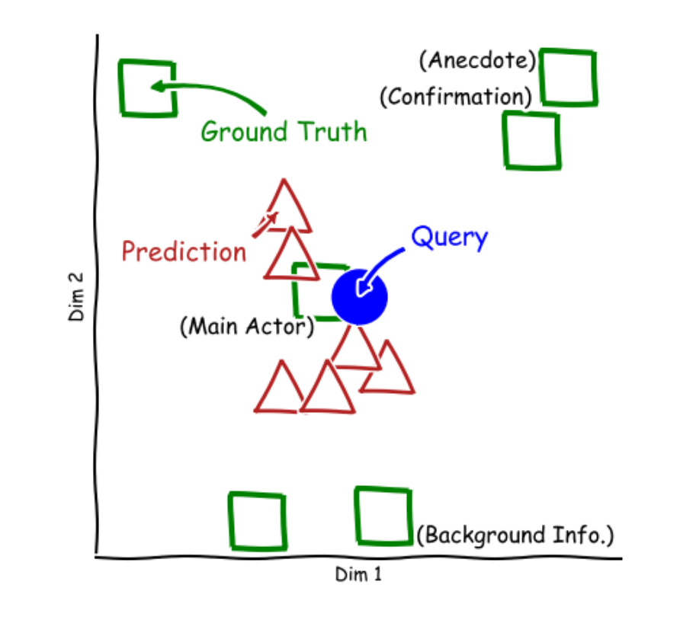
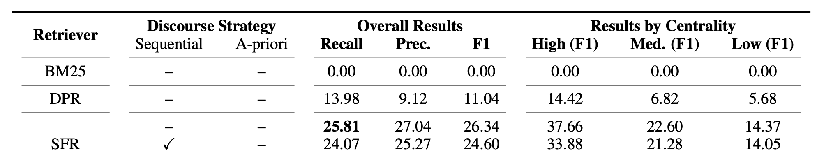
The Planning Scenarios – Creative Writing Agent
Spangher et al. 2024

Slide 26
The Planning Scenarios – Creative Writing Agent
Spangher et al. 2024

Slide 27
The Learning Approaches
Prompt-based
frameworks
End-to-end
Finetuning
Incorporating
Heuristics
Reinforcement
Learning
Search
Algorithm
Low-data
Partial-data
High-data
Little-to-no end-states or intermediate action states is available about the planning process.
End state information, but no actions, are available to the planning process.
Pre-final text and/or action sequences are available for the models to train on.

Slide 28
The Learning Approaches
Prompt-based
frameworks
End-to-end
Finetuning
Incorporating
Heuristics
Reinforcement
Learning
Search
Algorithm
Low-data
Partial-data
High-data
Little-to-no end-states or intermediate action states is available about the planning process.
End state information, but no actions, are available to the planning process.
Pre-final text and/or action sequences are available for the models to train on.

Slide 29
The Learning Approaches
Prompt-based
frameworks
End-to-end
Finetuning
Incorporating
Heuristics
Reinforcement
Learning
Search
Algorithm
Low-data
Partial-data
High-data
Little-to-no end-states or intermediate action states is available about the planning process.
End state information, but no actions, are available to the planning process.
Pre-final text and/or action sequences are available for the models to train on.

Slide 30


The Learning Approaches – Prompt Framework
For prompt to succeed …
1. Agent MUST be familiar with the domain.
2. The prompt contains sufficient information to address the query.
How to Write
an interesting
story ?

Slide 31

The Learning Approaches – Prompt Framework
For prompt to succeed …
1. Agent MUST be familiar with the domain.
2. The prompt contains sufficient information to address the query.
The reality though …
~10% Success rate on WebArena
~15% Match in turning points identification
No improvement on journalist source finding
poor tool usage planning performance
How to achieve XXX?

Slide 32

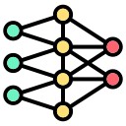
The Learning Approaches – End-to-End finetuning
Instruction: We are planning to watch a movie tonight.
Trajectory: API_1, API_2, API_3 …
Train

Slide 33
The Learning Approaches – End-to-End finetuning
Instruction: We are planning to watch a movie tonight.
Trajectory: API_1, API_2, API_3 …
Train
Weakness:
1. Requires tons of data
2. Not generalizable to new data entries (requires re-finetuning).
3. Hallucination.
4. Poor interpretability.

Slide 34
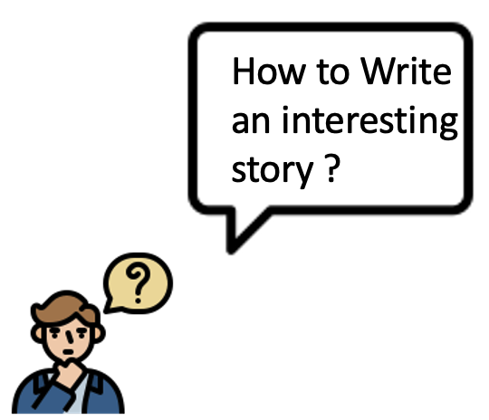
The Learning Approaches – Incorporating Heuristics
I want to write
about Beyonce, what sources should I use?

Slide 35
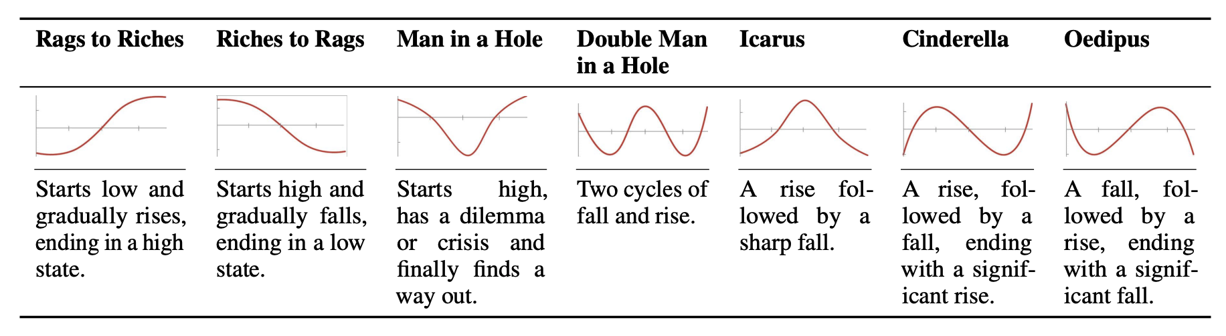

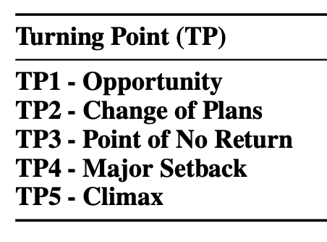
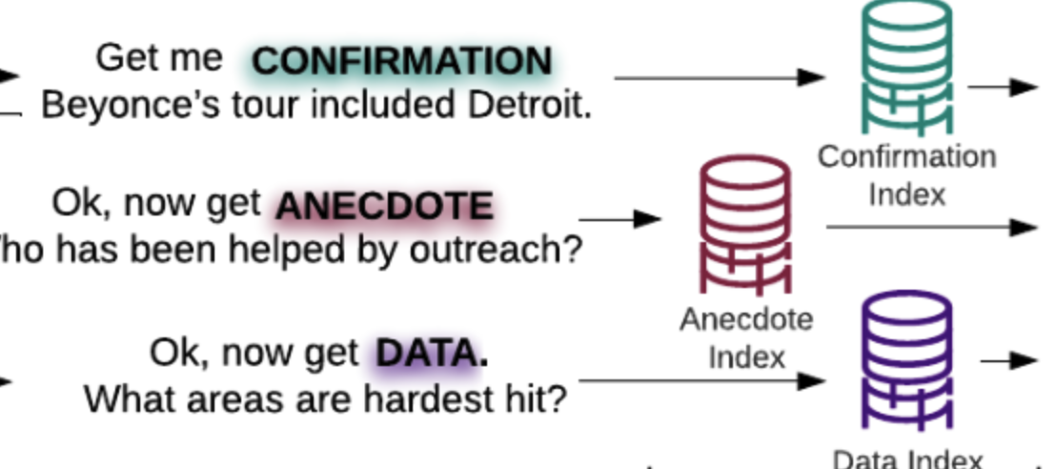
The Learning Approaches – Incorporating Heuristics
I want to write
about Beyonce, what sources should I use?

Slide 36
The Learning Approaches – Incorporating Heuristics
How to plan and incorporate given these heuristics?
I want to write
about Beyonce, what sources should I use?

Slide 37
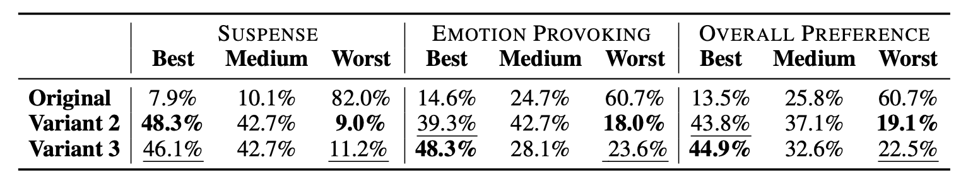
The Learning Approaches – Incorporating Heuristics
How to Write
an interesting
story ?

Slide 38
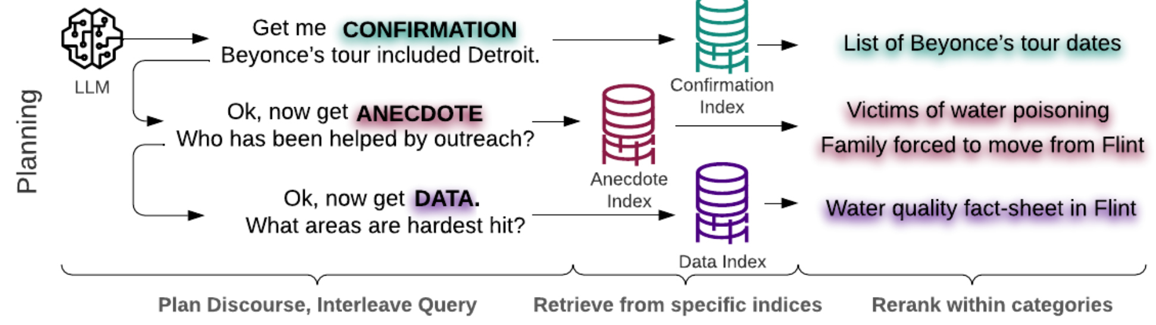
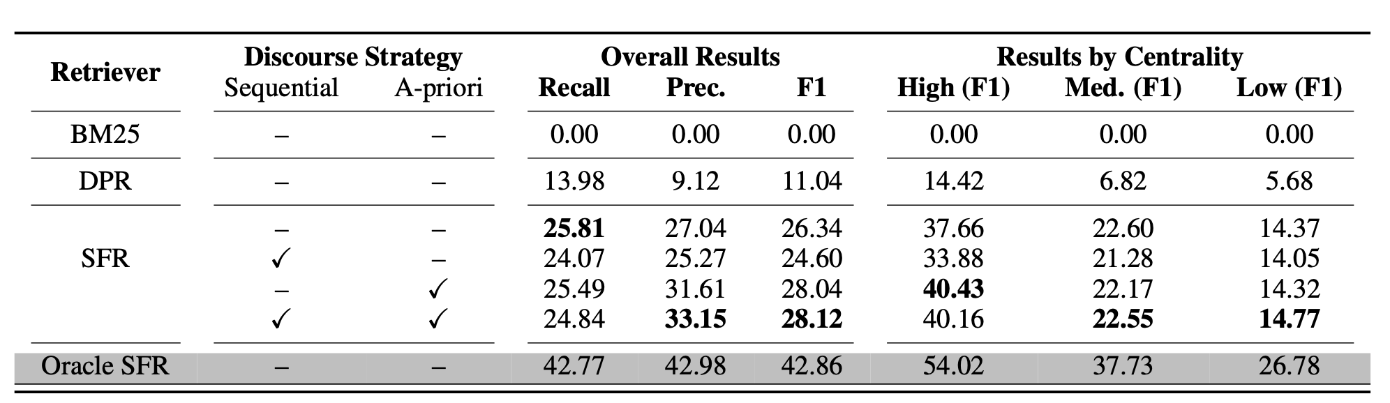
The Learning Approaches – Incorporating Heuristics

Slide 39
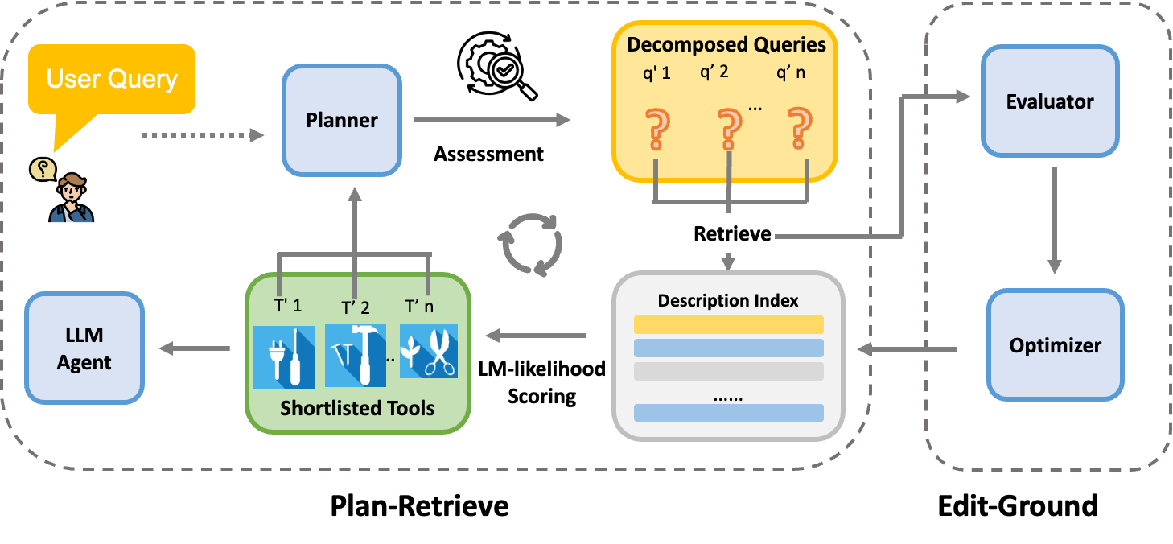
The Learning Approaches – Incorporating Heuristics
LLMs’
Huang et al. 2024

Slide 40
Takeaways:
Incorporating Heuristics (human prior knowledge) improves agent performances.
Quite efficient.
Cons: require experts.

Slide 41
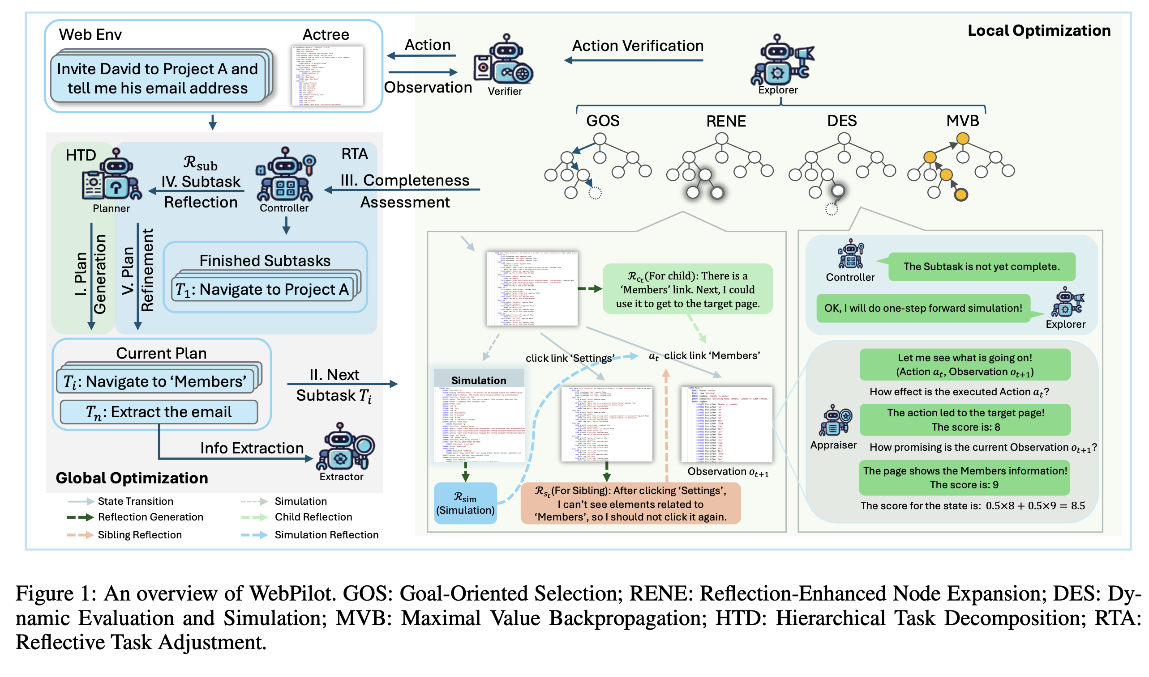
The Learning Approaches – Search

Slide 42
Takeaways:
Search can be costly.
How to make it faster and cheaper?

Slide 43
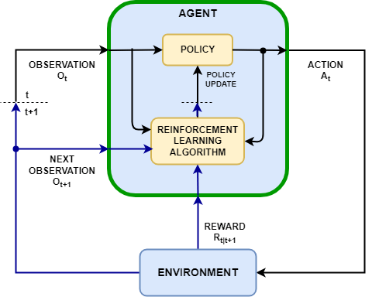
The Learning Approaches – RL

Slide 44
The Learning Approaches – RL
Why is this not working for web agents?

Slide 45

Notes:
Given the probelm formulation, we pose this API shortlisitng as information retrieval task
And a popular solution is use a bi-encoder here. The user query would be converted to a query vector, and we encode each API by its descrpiton to get a index base.
Lastly, we compute semantic similarity between the user query and the API index to find the most relevant API.

Slide 46
Thanks
Notes:
Given the probelm formulation, we pose this API shortlisitng as information retrieval task
And a popular solution is use a bi-encoder here. The user query would be converted to a query vector, and we encode each API by its descrpiton to get a index base.
Lastly, we compute semantic similarity between the user query and the API index to find the most relevant API.

