Slide 1
Welcome to CSCI 662
Take HANDOUTS if YOU LIKE
All Material should be online (https://jonmay.github.io/USC-CS662/)
Take SLACK SURVEY about printouts
You can also take freshly dried figs from my tree

Slide 2
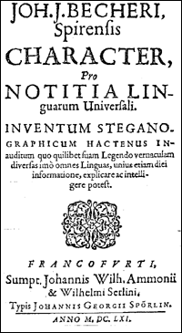
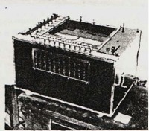
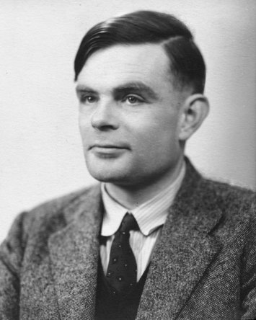

Slide 3
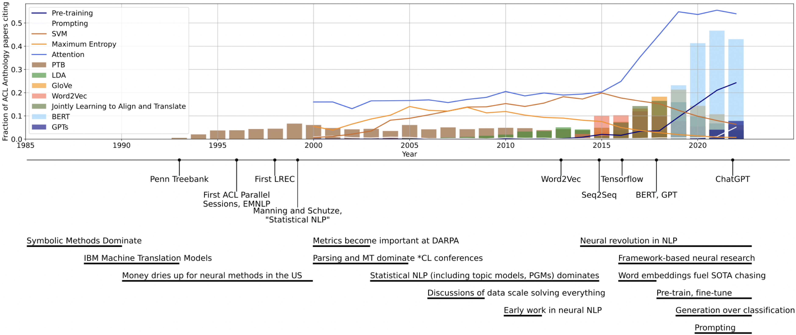
Jon Graduates
line = fraction of papers using the term
bar = fraction of papers citing
“To Build Our Future, We Must Know Our Past: Contextualizing Paradigm Shifts in Natural Language Processing”
Gururaja et al EMNLP 23

Slide 4
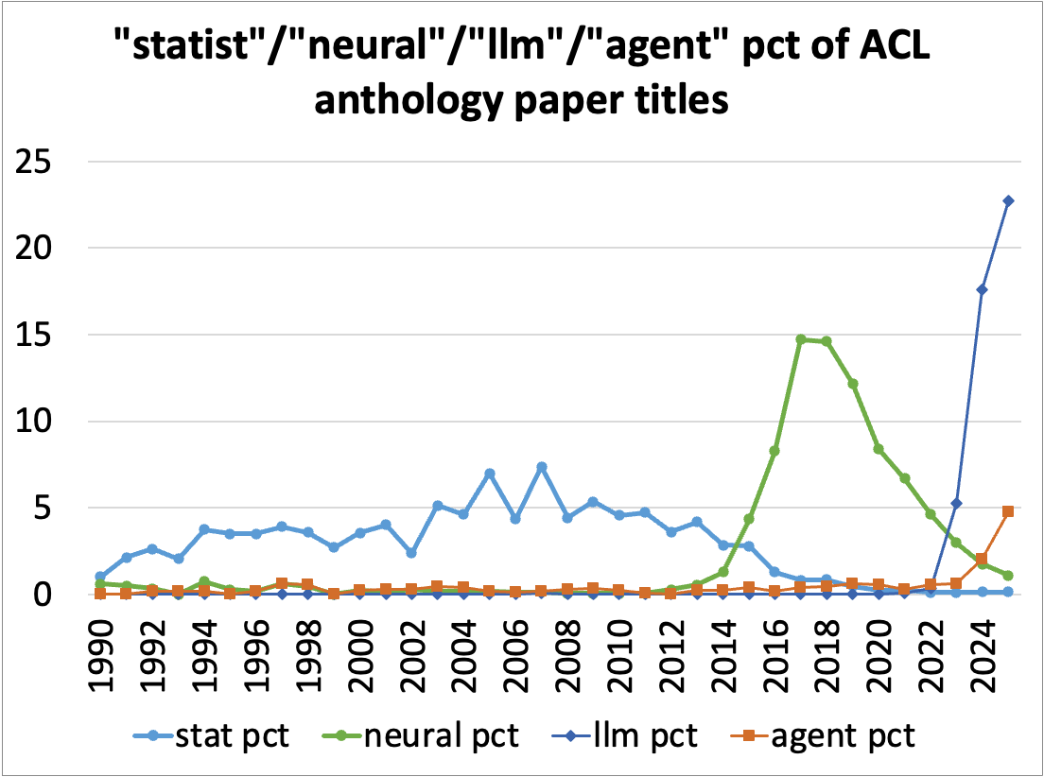

Slide 5
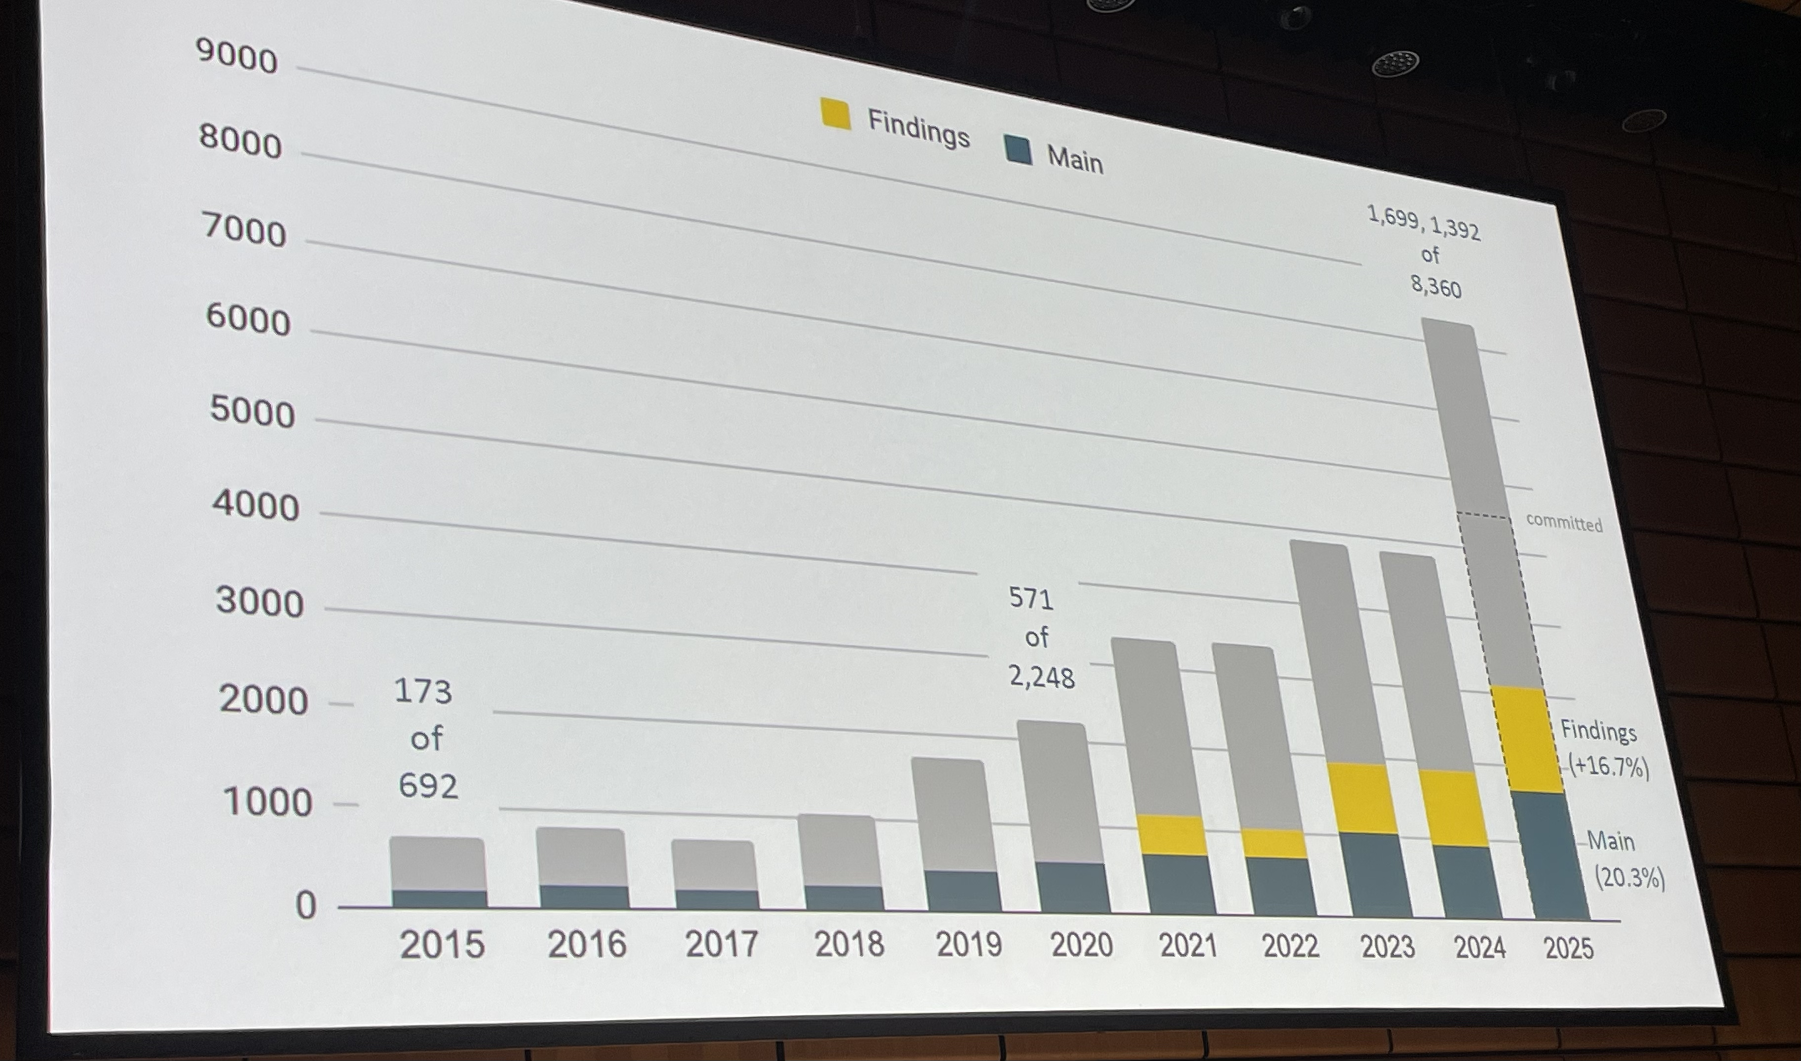
ACL 25 (7/28/25)

Slide 6
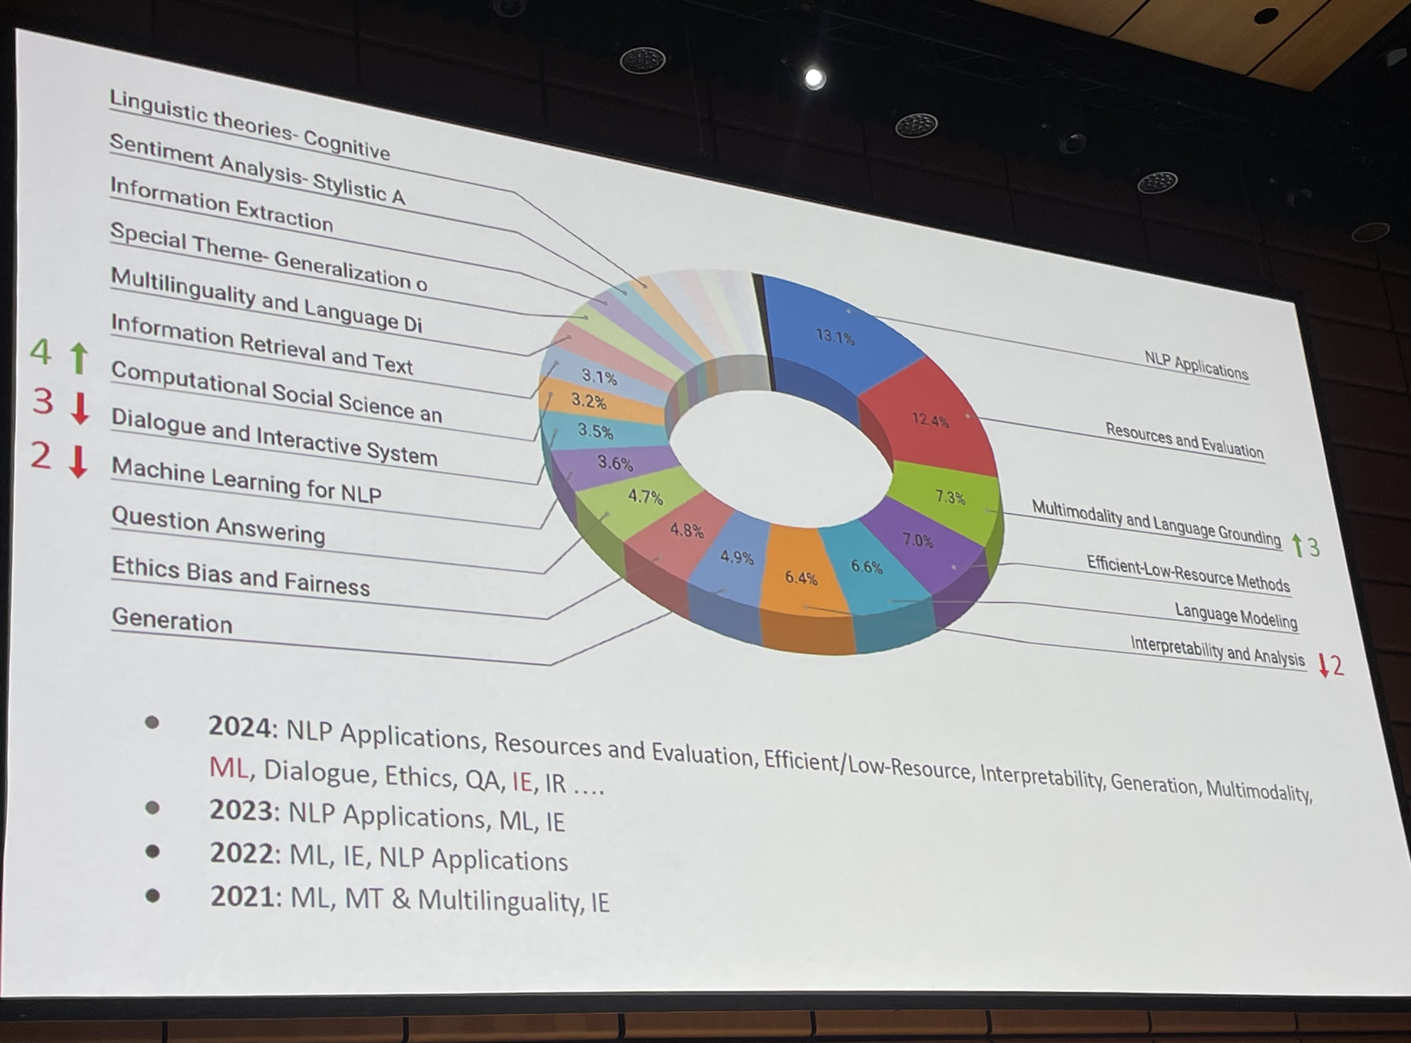

Slide 7
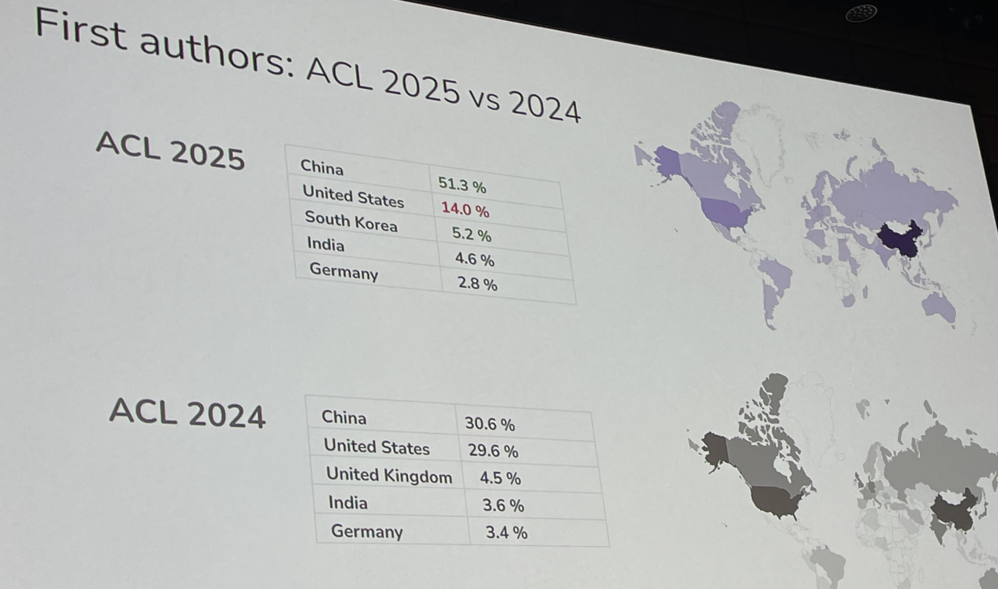
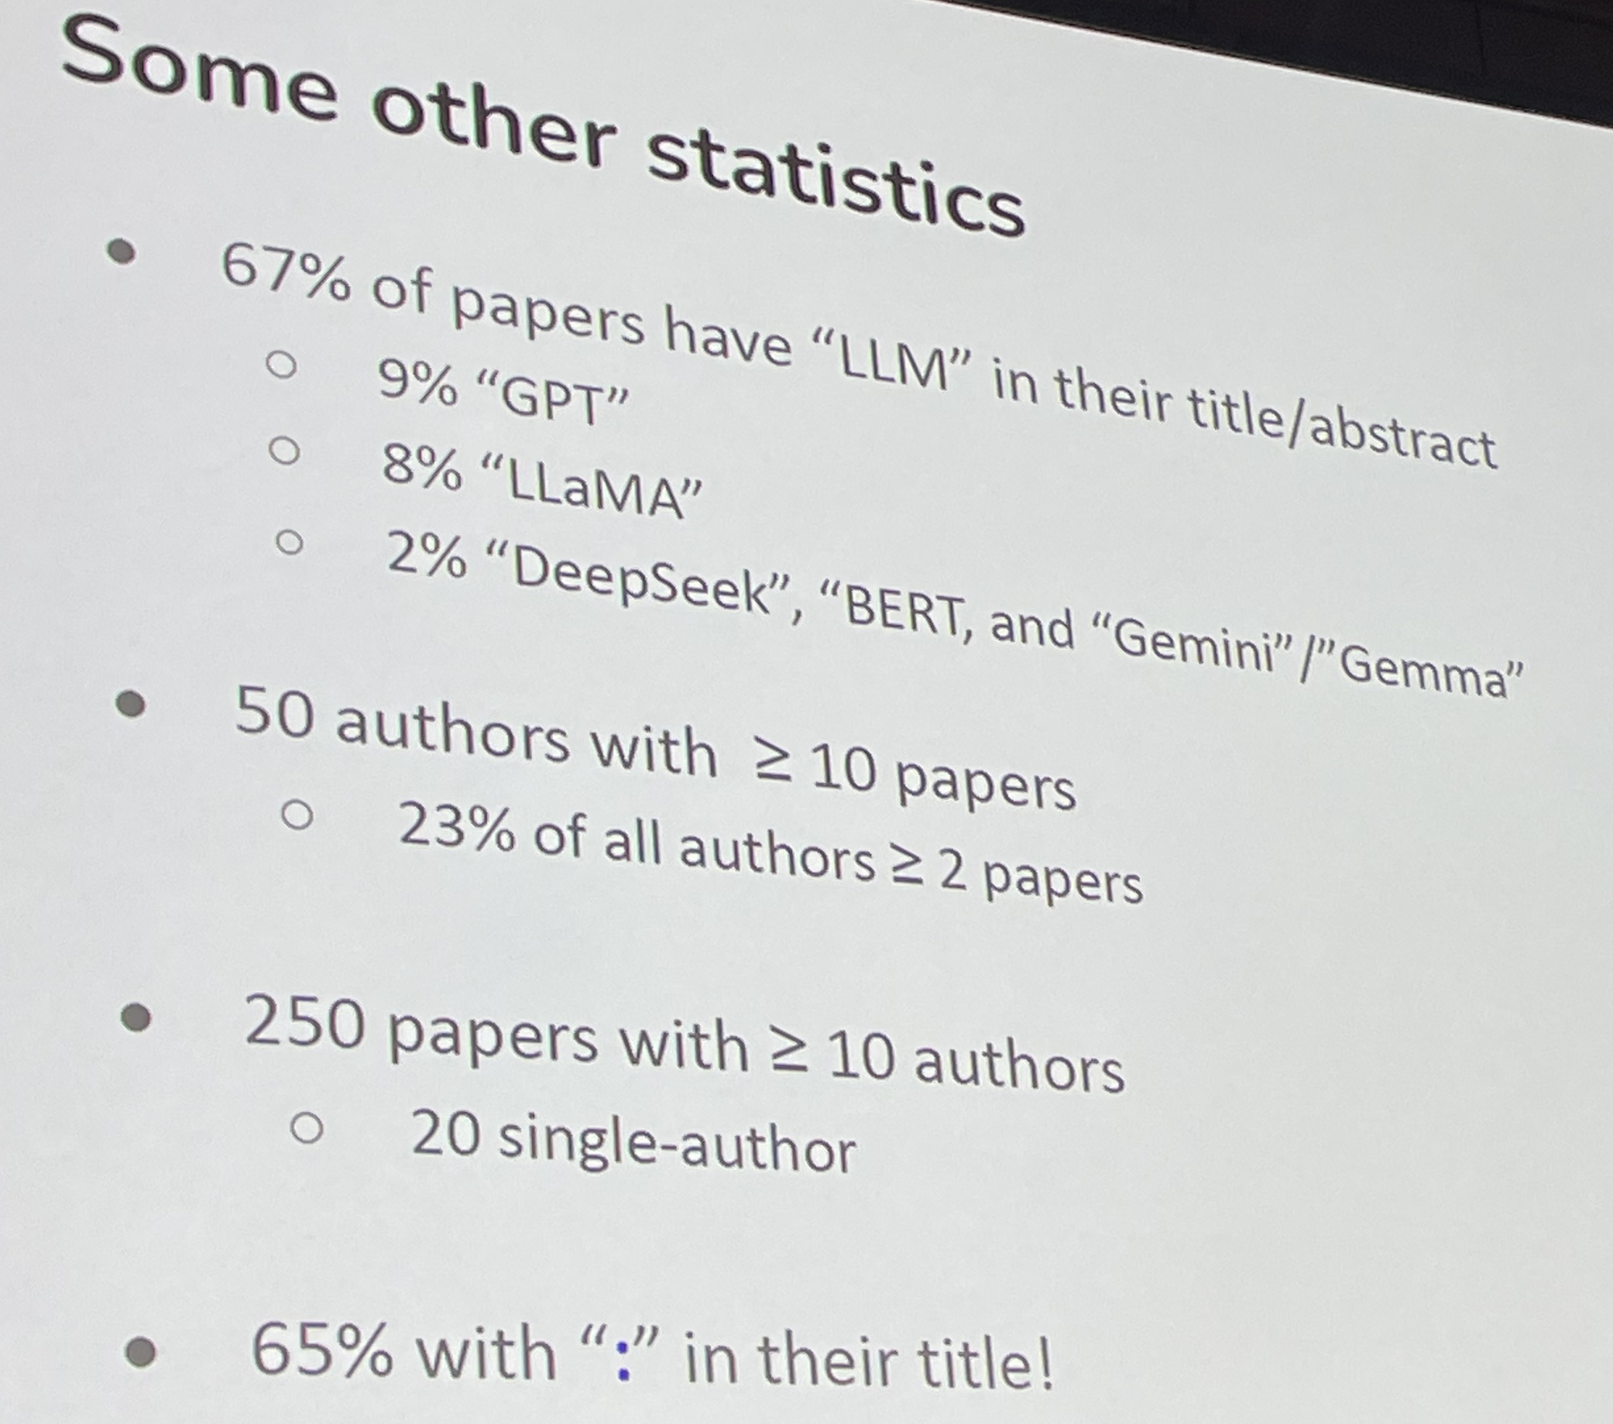
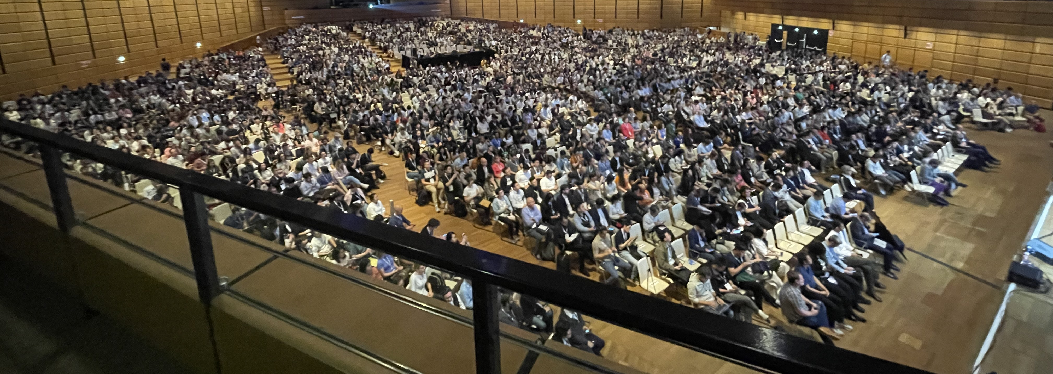

Slide 8
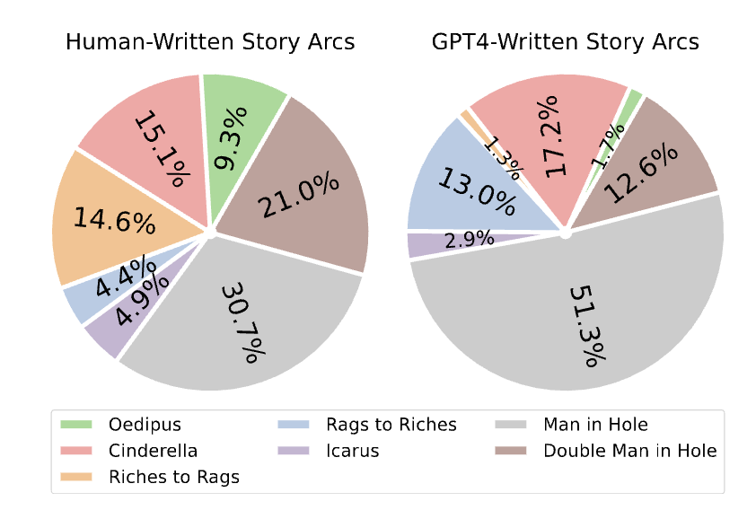
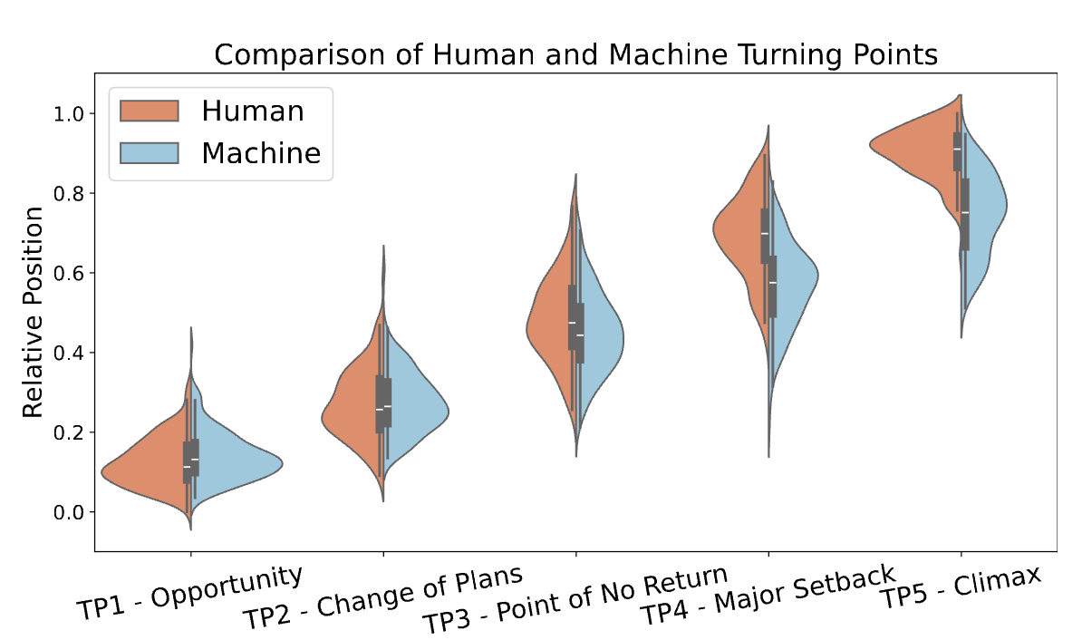
Are Large Language Models Capable of Generating Human-Level Narratives?
Yufei Tian, et al. EMNLP ‘24

Slide 9
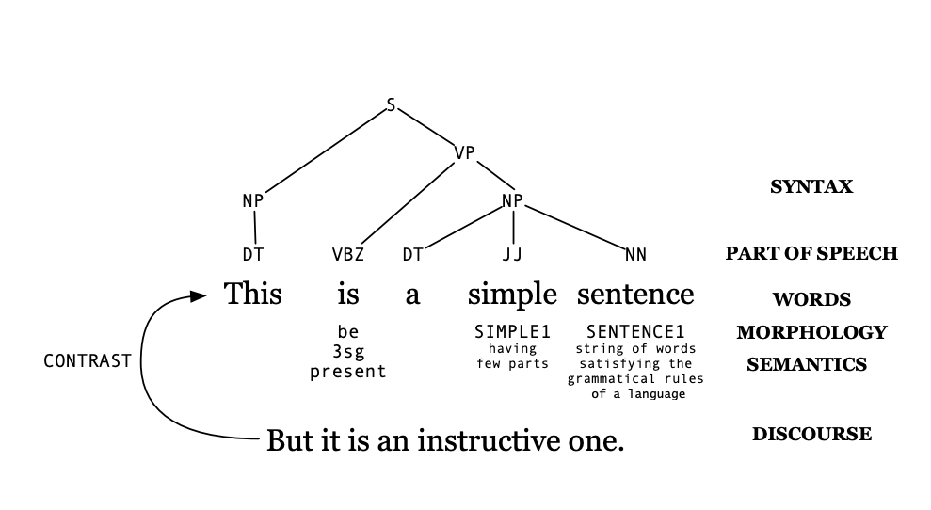

Slide 10
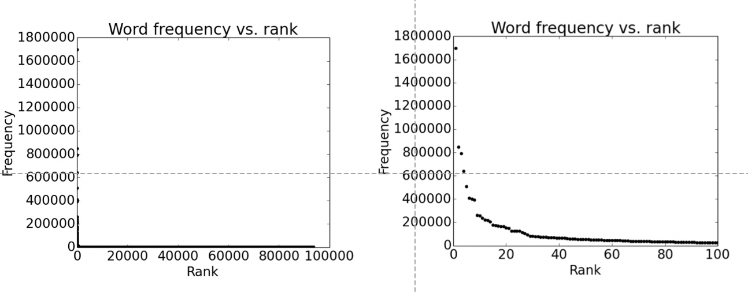

Slide 11
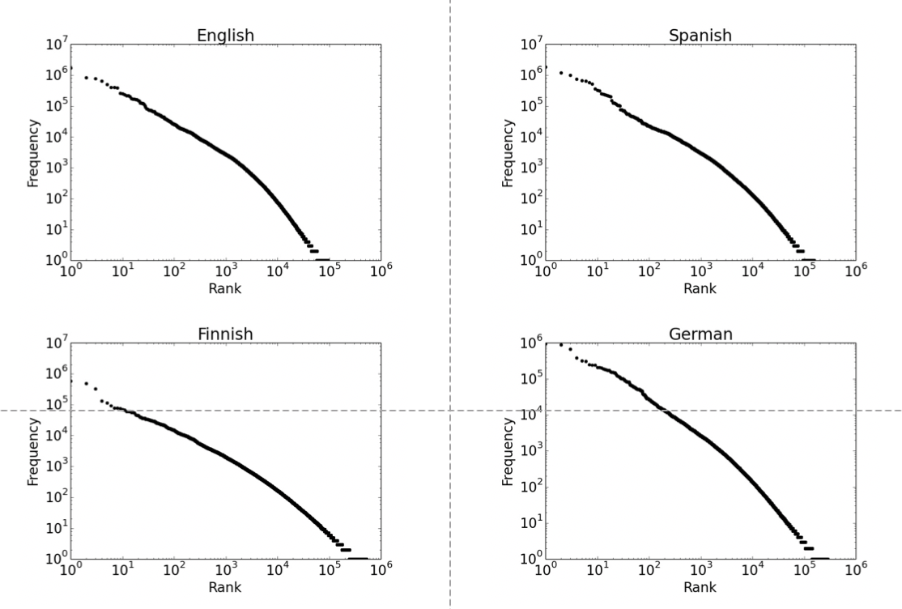

Slide 12
